Slide 1
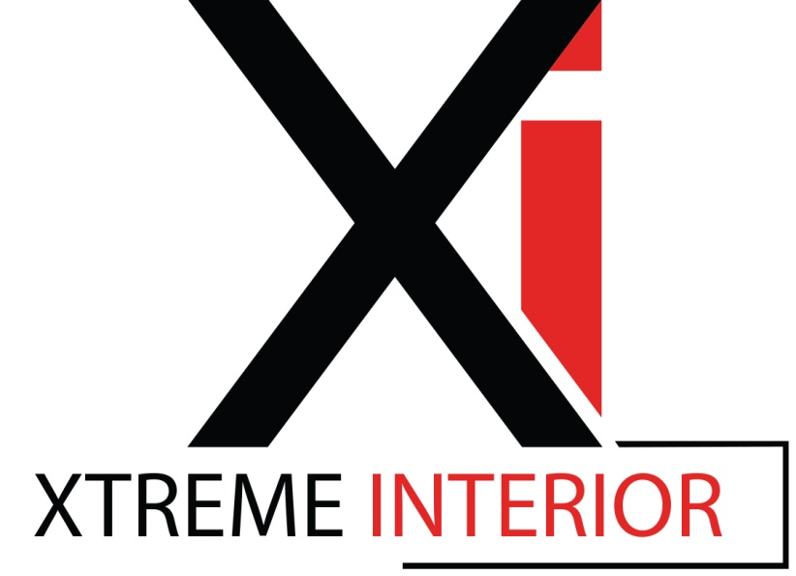
Extruded Aluminum Trim Products: Innovative Solutions for Interior Applications
Notes:
Extruded Aluminum Trim Products: Innovative Solutions for Interior Applications

Slide 2
Program Registration Course Number: XI_CEU Learning Units: 1.0 LU/HSW Hour
XtremeInterior is a Registered Provider with The American Institute of Architects Continuing Education Systems (AIA/CES). Credit(s) earned on completion of this program will be reported to AIA/CES for AIA members. Certificates of Completion for both AIA members and non-AIA members are available upon request. This program is registered with AIA/CES for continuing professional education. As such, it does not include content that may be deemed or construed to be an approval or endorsement by the AIA of any material of construction or any method or manner of handling, using, distributing, or dealing in any material or product.
Questions related to specific materials, methods, and services will be addressed at the conclusion of this presentation.
This presentation is protected by US and International Copyright laws. Reproduction, distribution, display and use of the presentation without written permission of the speaker is prohibited.
- Provider Number: 40117877 -
Notes:
XtremeInterior is a Registered Provider with The American Institute of Architects Continuing Education Systems (AIA/CES). Credit(s) earned on completion of this program will be reported to AIA/CES for AIA members. Certificates of Completion for both AIA members and non-AIA members are available upon request. This program is registered with AIA/CES for continuing professional education. As such, it does not include content that may be deemed or construed to be an approval or endorsement by the AIA of any material of construction or any method or manner of handling, using, distributing, or dealing in any material or product.
Questions related to specific materials, methods, and services will be addressed at the conclusion of this presentation.
This presentation is protected by US and International Copyright laws. Reproduction, distribution, display and use of the presentation without written permission of the speaker is prohibited.

Slide 3
Learning Objectives:
Copyclip
At the end of this program, participants will be able to:
explain how extruded aluminum trim products can be utilized to improve and enhance drywall surfaces
explain the basic process of extruding aluminum
summarize the sustainable features and performance characteristics of aluminum
discuss the various profile and finish options that are available for aluminum interior trim products, and
state the methods and considerations related to the installation of aluminum trim products for interior spaces.
Notes:
Learning Objectives:
explain how extruded aluminum trim products can be utilized to improve and enhance drywall surfaces
summarize the sustainable features and performance characteristics of aluminum
discuss the various profile and finish options that are available for aluminum interior trim products, and
state the methods and considerations related to the installation of aluminum trim products for interior spaces.

Slide 4
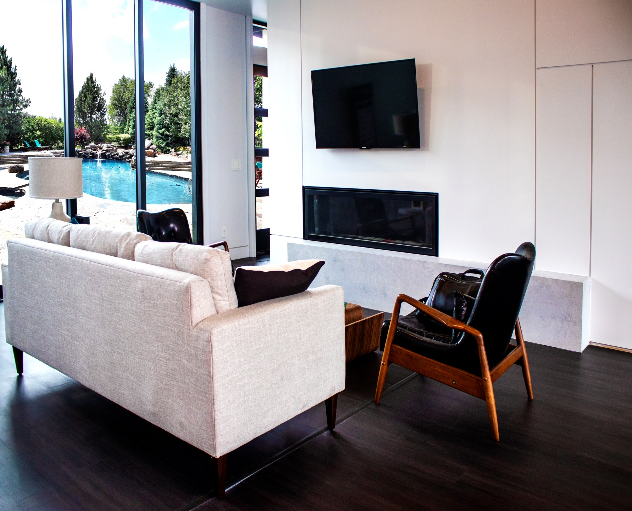
Interior Trim: “The details are not the details. They make the design.” Charles Eames
Notes:
Interior Trim:

Slide 5
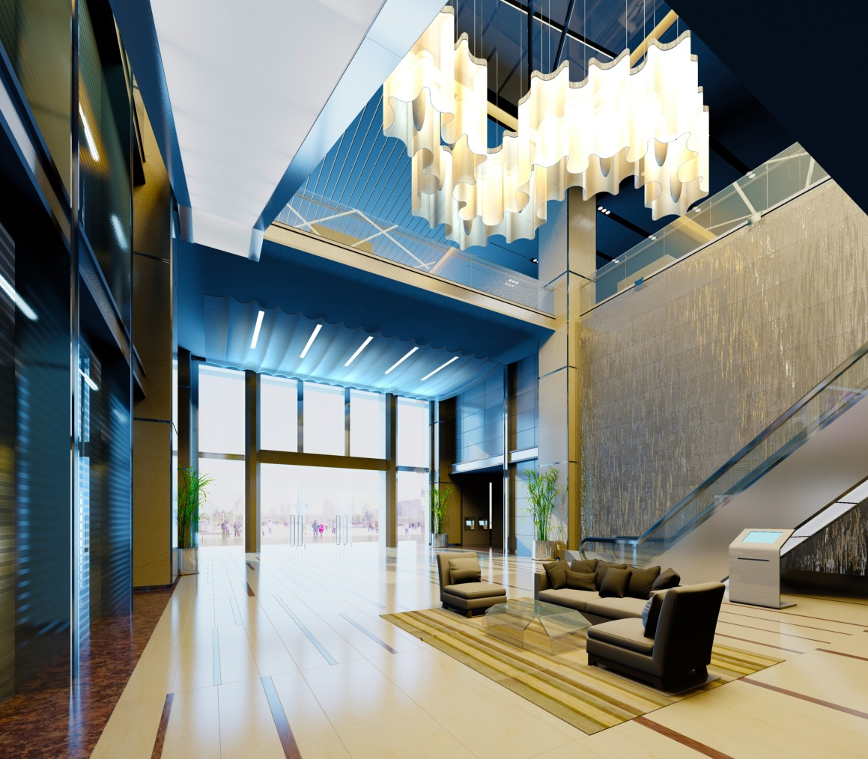
Detailing needs to meet an architectural design aesthetic, as well as durability and sustainability requirements
Specifying extruded aluminum interior trim products can contribute to all of these prerequisites
Notes:
Introduction:
God is in the details,” one of several iconic phrases attributed to Mies van der Rohe, continues to haunt architects. Whether the meaning is a disguised plea for creating ornamentation for a building’s exterior or interior, details are where architects can and do make a difference.
With today’s focus on green materials, detailing needs to meet an architectural design aesthetic, as well as durability and sustainability requirements.
Specifying extruded aluminum interior trim products is one instance where a knowledge of detailing can contribute to all of these prerequisites.
This course presents an overview of these innovative products, beginning with a review of the role of trim in commercial interior design.

Slide 6
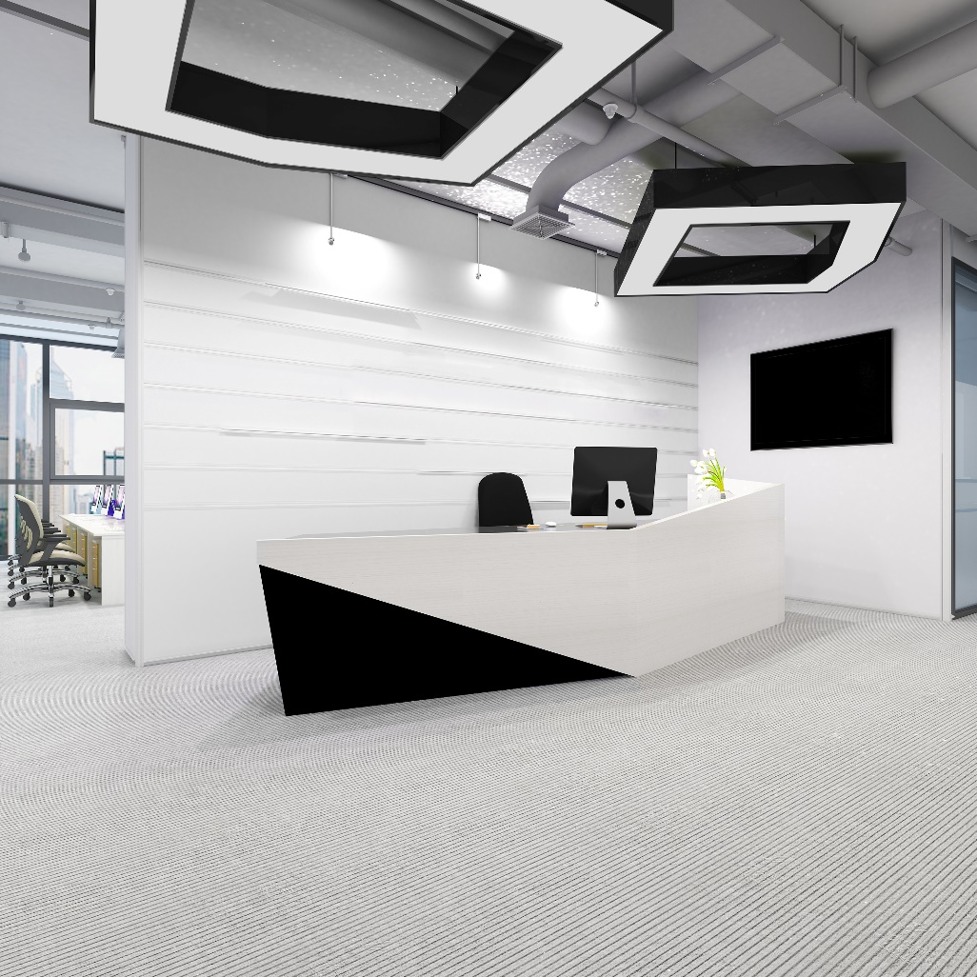
Why Use Extruded Aluminum Trim?
Provide architectural detail
Contribute to a modern aesthetic
Provide clean intersections of drywall
Create design elements from horizontal/vertical lines
Separate wall materials
Supply protection and a finished edge
for drywall or panel corners
Notes:
Why Use Trim?:
When building professionals talk about details, they are referring to the way the parts and pieces of an interior space come together: how they’re joined, how they intersect. Since the interior of a building has many intersecting materials, there are numerous details to consider in the design process. Ideally, they all support a single design language—an aesthetic. In contemporary architecture, these details can range from the sublimely simple to the ornate, with equally wide-ranging costs.
Trim is used for a variety of reasons:
Provide architectural detail
Contribute to a modern aesthetic
Provide clean intersections of drywall
Sculpt interior walls
Create horizontal/vertical lines
Separate wall materials
Supply protection and a finished edge for vertical drywall or panel corners

Slide 7
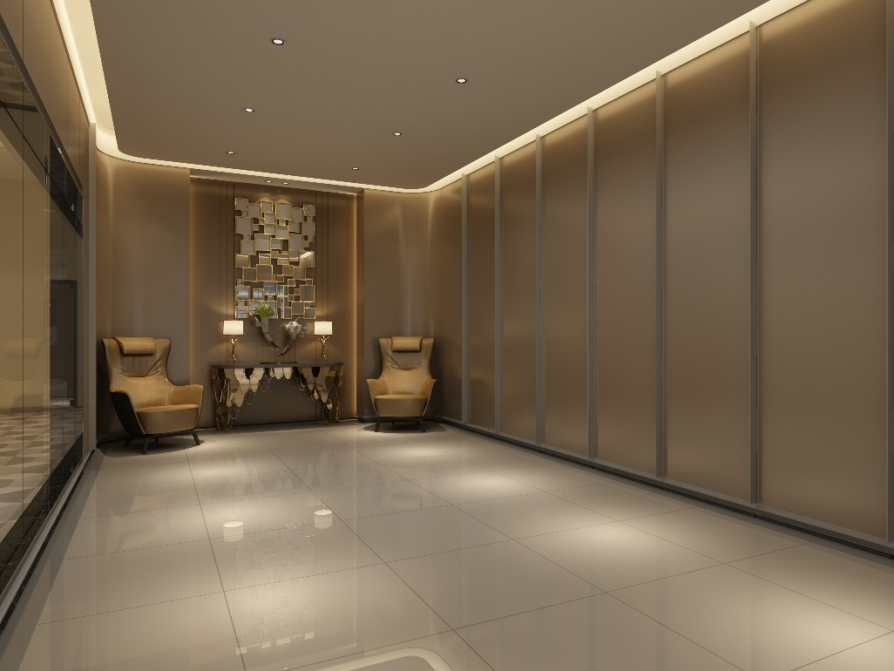
Trim Products Designed to Enhance Drywall Construction:
Design mostly driven by architects seeking cleaner details
Make it the feature, the focus, and the most impactful element of a well-designed space
Notes:
Trim Products Designed to Enhance Drywall Construction:
In the design and construction of commercial interiors, ⅝-inch-thick drywall on metal studs is still the high-value, low-cost workhorse for defining the perimeter of spaces, creating separation, and working as a very flexible substrate for limitless embellishments. It doesn’t get much credit for this because it is seen as so simple, so common, and so disposable.
With the cost of construction continuously rising, schedules shrinking, and field skill sets diminishing, designers and architects are constantly looking for ways to create unique spaces that leverage budgets, schedules, and craftsmanship availability—in short: to build spaces that produce the most “bang for the buck.”
To that end, available in the market is a new line of aluminum trim products designed and manufactured to enhance all of the practical aspects of drywall construction and transform it into a design medium that can make it the feature, the focus, and the most impactful element of a well-designed space. These modern interior trim products are sustainable, durable, lightweight, and easy to use.

Slide 8
Advantages of Extruded Aluminum Trim:
Aluminum trims can withstand greater daily abuse than most materials
Aluminum adds durability and longevity to construction
Other trim materials cannot achieve the same level of detail and design
Aluminum (when anodized or with a polished finish) is more aesthetically pleasing
Extruded aluminum trims install straight and true.
Notes:
Why Extruded Aluminum?:
Depending on the application, trim products may be made of a variety of materials including aluminum, polyvinyl chloride (PVC), wood (baseboards), and rubber (corner guards).
Advantages of extruded aluminum trim:
Aluminum trims can withstand greater daily abuse than most materials as they are stronger, maintain their shape better, and are less vulnerable to damage than non-metal alternatives.
Aluminum adds durability and longevity to construction, whereas PVC deteriorates over time.
Other trim materials cannot achieve the same level of detail and design.
Aluminum (when anodized or with a polished finish) is more aesthetically pleasing and provides the designer the ability to match a finish with doors, windows, frames, etc.
Extruded aluminum trims install straight and true.
A more in-depth discussion on extruded aluminum is presented in the next section of the course.

Slide 9
Extruded Aluminum:
Notes:
Extruded Aluminum:

Slide 10
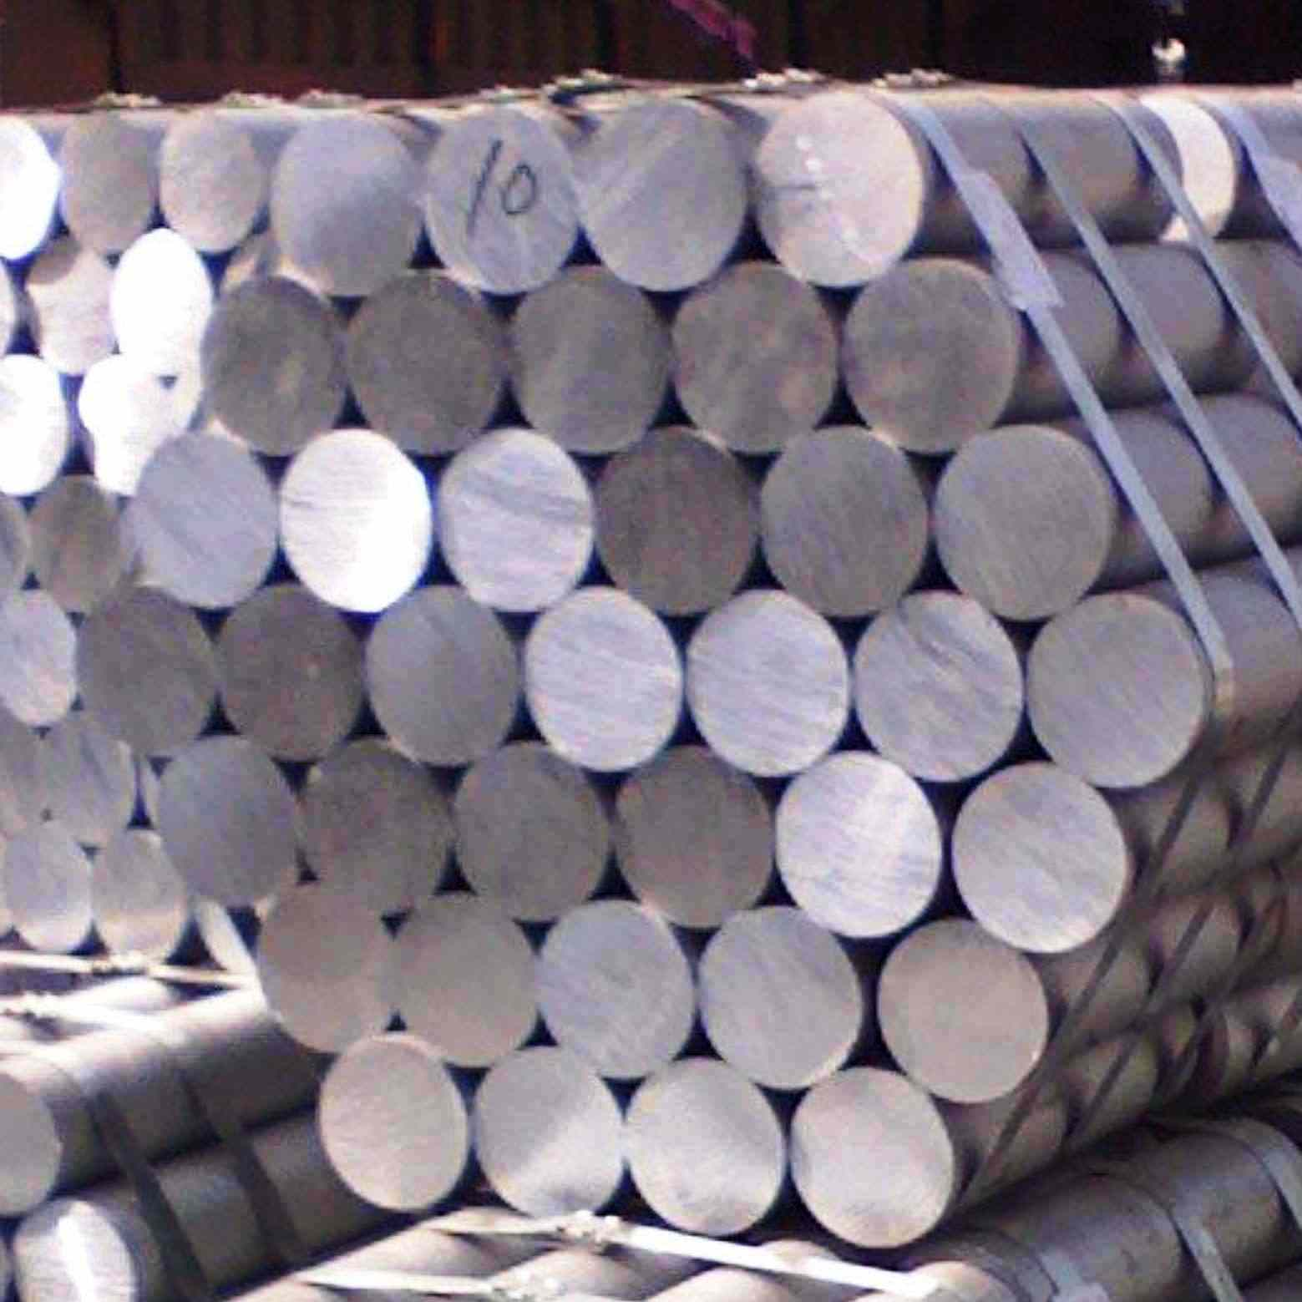
What Is Aluminum Extrusion?
Aluminum is the most abundant mineral in the earth's crust. Derived from bauxite, and is mined from the earth.
After initial mining process, a form called alumina undergoes smelting and alloying, producing solid billets of cast metal from which extruded aluminum shapes or profiles are made.
Billets are 8” – 12” diameter
Notes:
What Is Aluminum Extrusion?:
Aluminum, the most abundant mineral in the earth’s crust, is derived from bauxite deposits mined from the earth.
After initial processing, a form called alumina undergoes smelting and alloying, producing solid billets of cast metal from which extruded aluminum shapes or profiles are made. Following the extrusion process, a variety of options (e.g., anodizing and painting) are available to modify the color, texture, and brightness of the aluminum’s finish.
Aluminum is easily machined due to its malleability, yet it is one-third the density and stiffness of steel.
Aluminum extrusion is a highly versatile metal-forming process that has a wide array of desirable physical characteristics that will be explored in this section of the course.

Slide 11
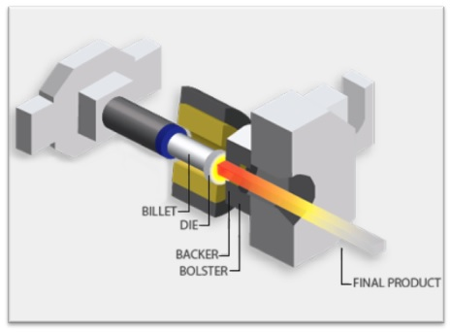
What Is Aluminum Extrusion?
Once the billets are created and heated they are pressed through the die which creates the intended extrusion shape.
After passing through the die it will go through a backer and bolster which maintain the shape will adding space
Notes:
What Is Aluminum Extrusion?:
Aluminum, the most abundant mineral in the earth’s crust, is derived from bauxite deposits mined from the earth.
After initial processing, a form called alumina undergoes smelting and alloying, producing solid billets of cast metal from which extruded aluminum shapes or profiles are made. Following the extrusion process, a variety of options (e.g., anodizing and painting) are available to modify the color, texture, and brightness of the aluminum’s finish.
Aluminum is easily machined due to its malleability, yet it is one-third the density and stiffness of steel.
Aluminum extrusion is a highly versatile metal-forming process that has a wide array of desirable physical characteristics that will be explored in this section of the course.

Slide 12
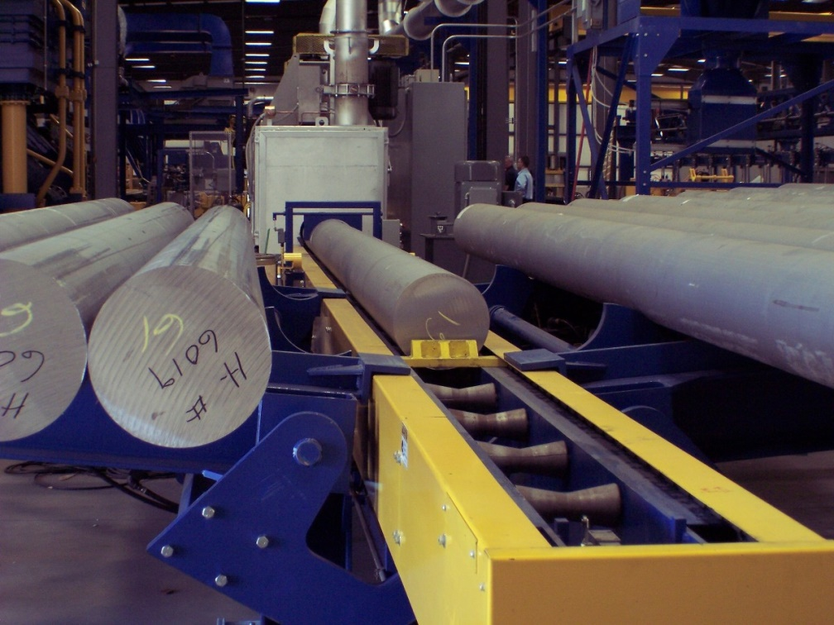
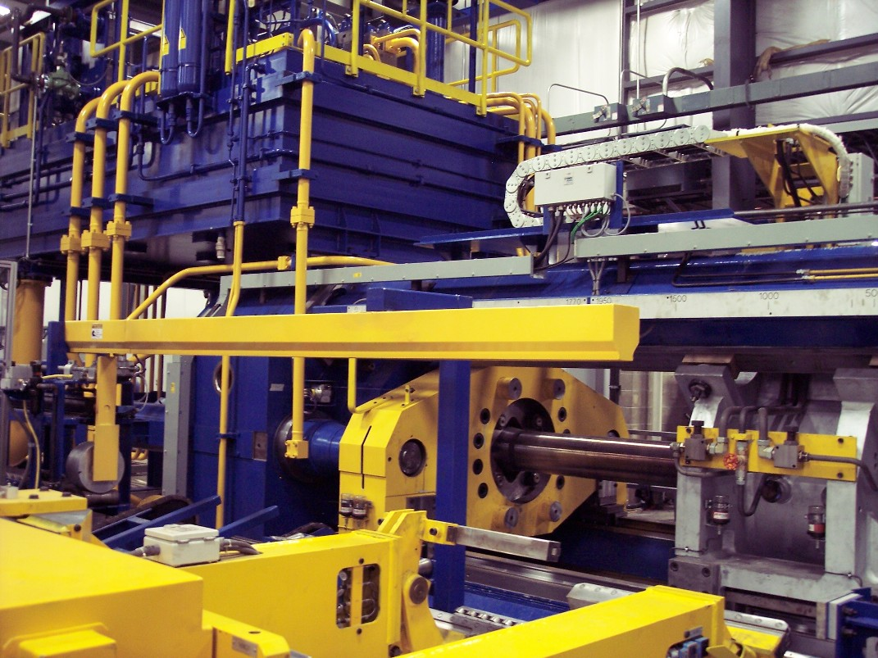
What Is Aluminum Extrusion?
Notes:
What Is Aluminum Extrusion?:
Aluminum, the most abundant mineral in the earth’s crust, is derived from bauxite deposits mined from the earth.
After initial processing, a form called alumina undergoes smelting and alloying, producing solid billets of cast metal from which extruded aluminum shapes or profiles are made. Following the extrusion process, a variety of options (e.g., anodizing and painting) are available to modify the color, texture, and brightness of the aluminum’s finish.
Aluminum is easily machined due to its malleability, yet it is one-third the density and stiffness of steel.
Aluminum extrusion is a highly versatile metal-forming process that has a wide array of desirable physical characteristics that will be explored in this section of the course.

Slide 13
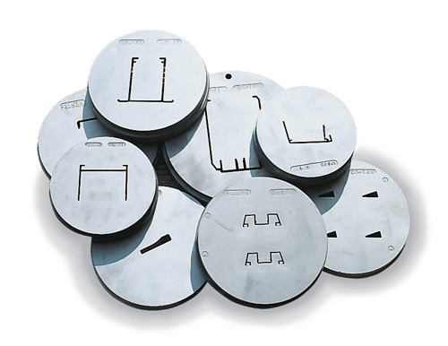
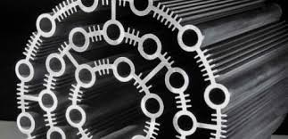
What Is Aluminum Extrusion?
Notes:
What Is Aluminum Extrusion?:
Aluminum, the most abundant mineral in the earth’s crust, is derived from bauxite deposits mined from the earth.
After initial processing, a form called alumina undergoes smelting and alloying, producing solid billets of cast metal from which extruded aluminum shapes or profiles are made. Following the extrusion process, a variety of options (e.g., anodizing and painting) are available to modify the color, texture, and brightness of the aluminum’s finish.
Aluminum is easily machined due to its malleability, yet it is one-third the density and stiffness of steel.
Aluminum extrusion is a highly versatile metal-forming process that has a wide array of desirable physical characteristics that will be explored in this section of the course.

Slide 14
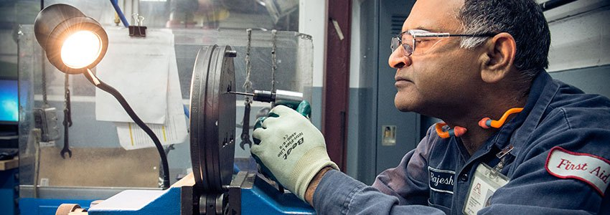
What Is Aluminum Extrusion?
Notes:
What Is Aluminum Extrusion?:
Aluminum, the most abundant mineral in the earth’s crust, is derived from bauxite deposits mined from the earth.
After initial processing, a form called alumina undergoes smelting and alloying, producing solid billets of cast metal from which extruded aluminum shapes or profiles are made. Following the extrusion process, a variety of options (e.g., anodizing and painting) are available to modify the color, texture, and brightness of the aluminum’s finish.
Aluminum is easily machined due to its malleability, yet it is one-third the density and stiffness of steel.
Aluminum extrusion is a highly versatile metal-forming process that has a wide array of desirable physical characteristics that will be explored in this section of the course.

Slide 15
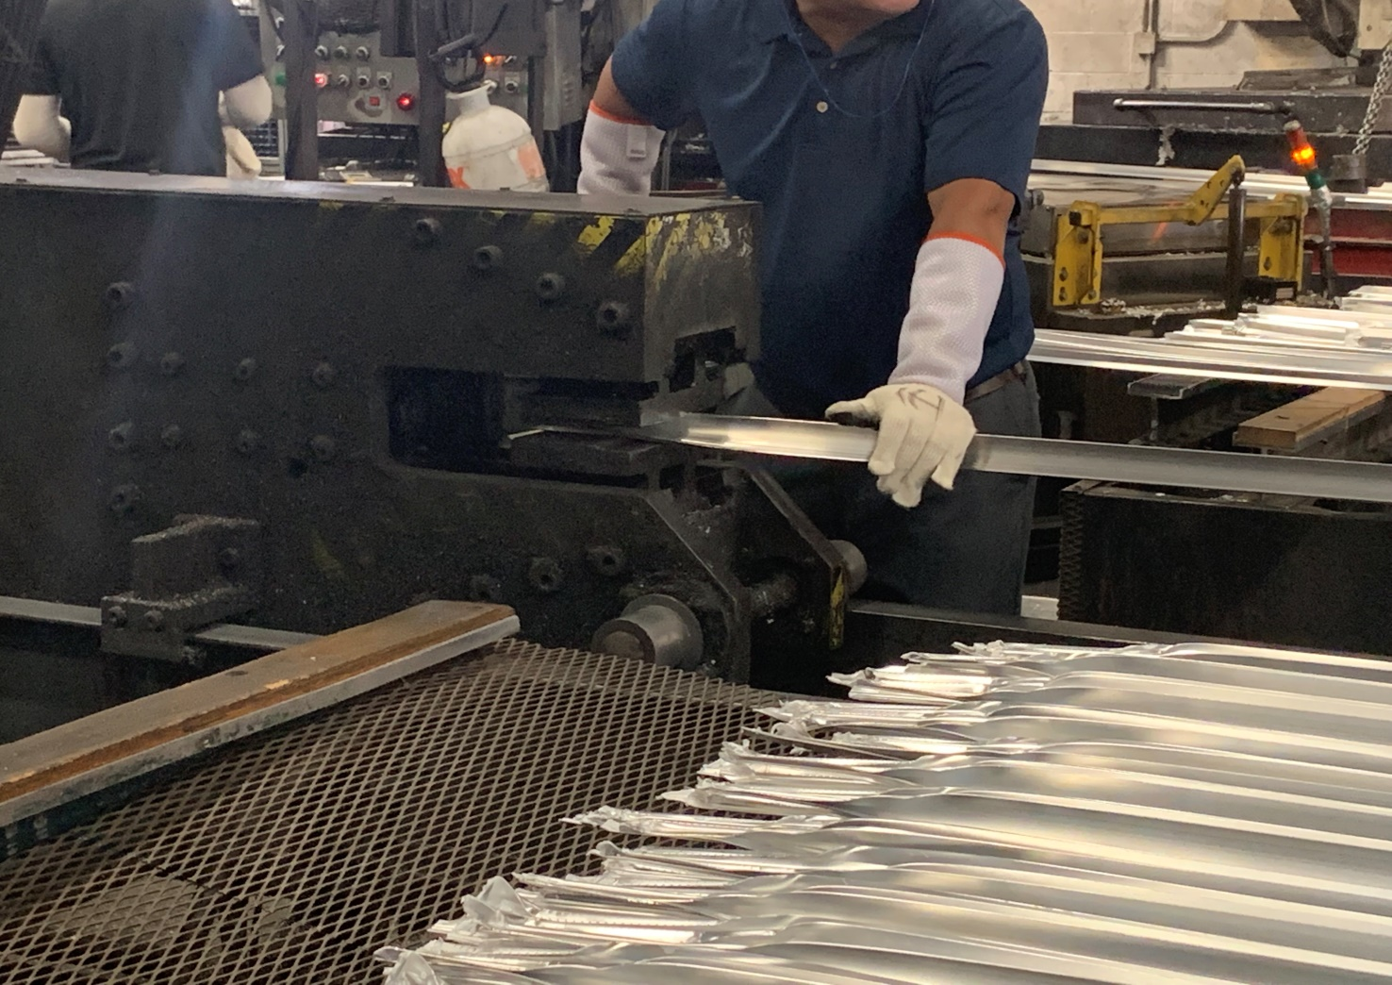
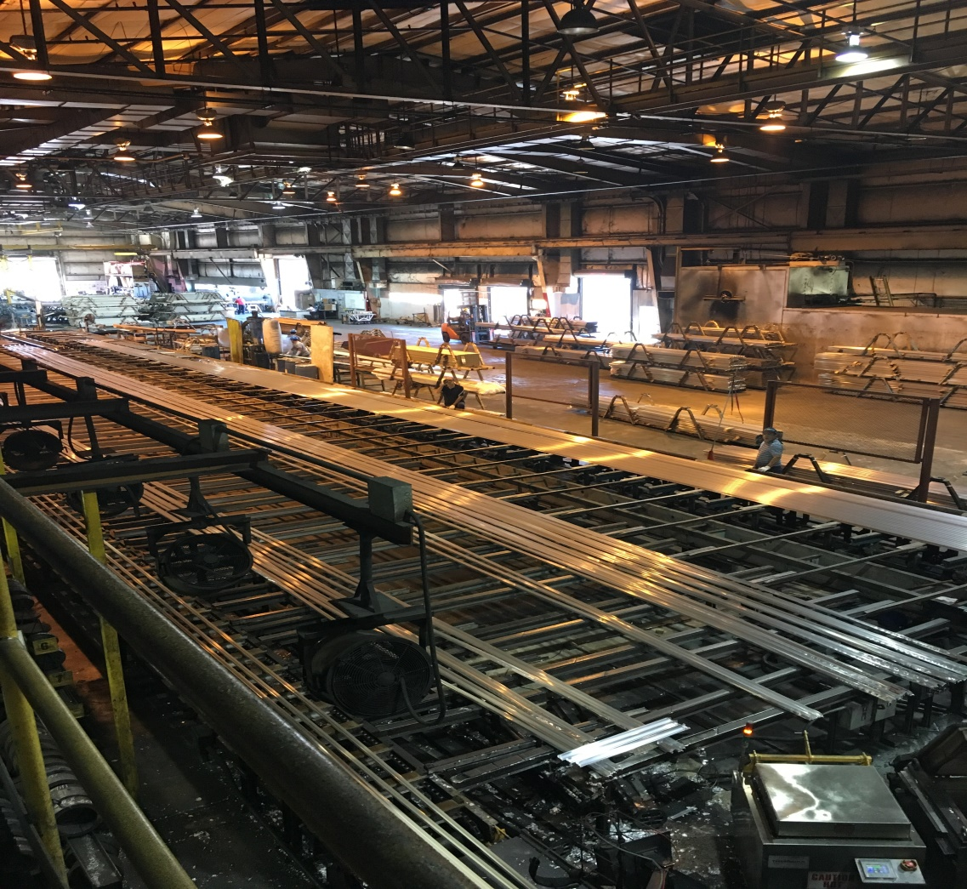
What Is Aluminum Extrusion?
Notes:
What Is Aluminum Extrusion?:
Aluminum, the most abundant mineral in the earth’s crust, is derived from bauxite deposits mined from the earth.
After initial processing, a form called alumina undergoes smelting and alloying, producing solid billets of cast metal from which extruded aluminum shapes or profiles are made. Following the extrusion process, a variety of options (e.g., anodizing and painting) are available to modify the color, texture, and brightness of the aluminum’s finish.
Aluminum is easily machined due to its malleability, yet it is one-third the density and stiffness of steel.
Aluminum extrusion is a highly versatile metal-forming process that has a wide array of desirable physical characteristics that will be explored in this section of the course.

Slide 16
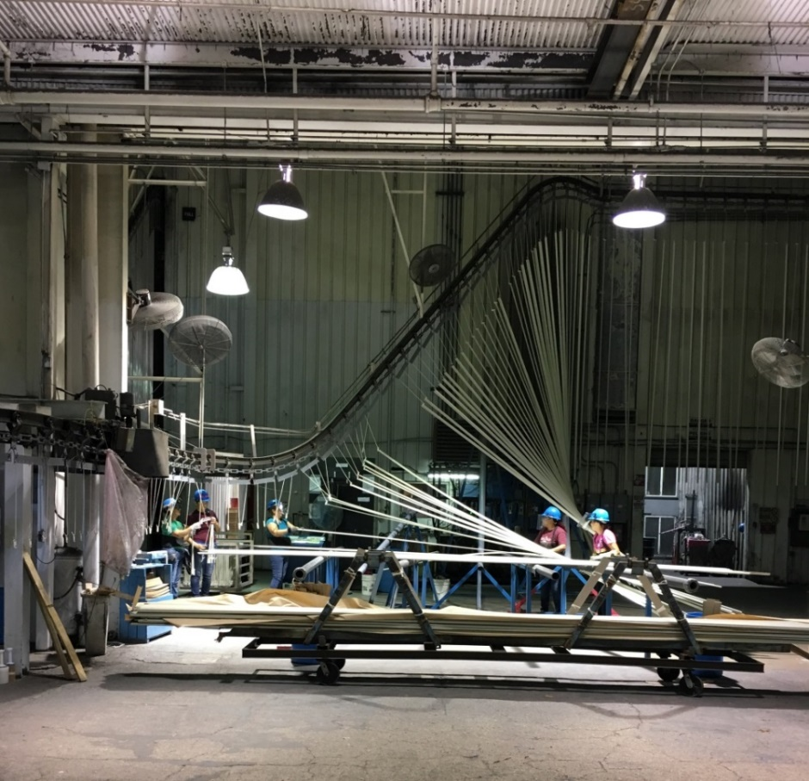
Type 6063 – T5 Aluminum:
Used for most extruded shapes
Aluminum alloy with magnesium and silicon
Very smooth surface
Best alloy for anodizing
T5 indicates it has been artificially aged and moderately heat-treated
Notes:
Type 6063-T5 Aluminum:
Most extruded shapes for architectural use are fabricated from 6063, an aluminum alloy with magnesium and silicon as the alloying elements.
Type 6063-T5 aluminum—commonly referred to as the architectural alloy—has a very smooth surface and is the best alloy suited for anodizing applications.
The T5 designation indicates it has been artificially aged and moderately heat-treated.

Slide 17
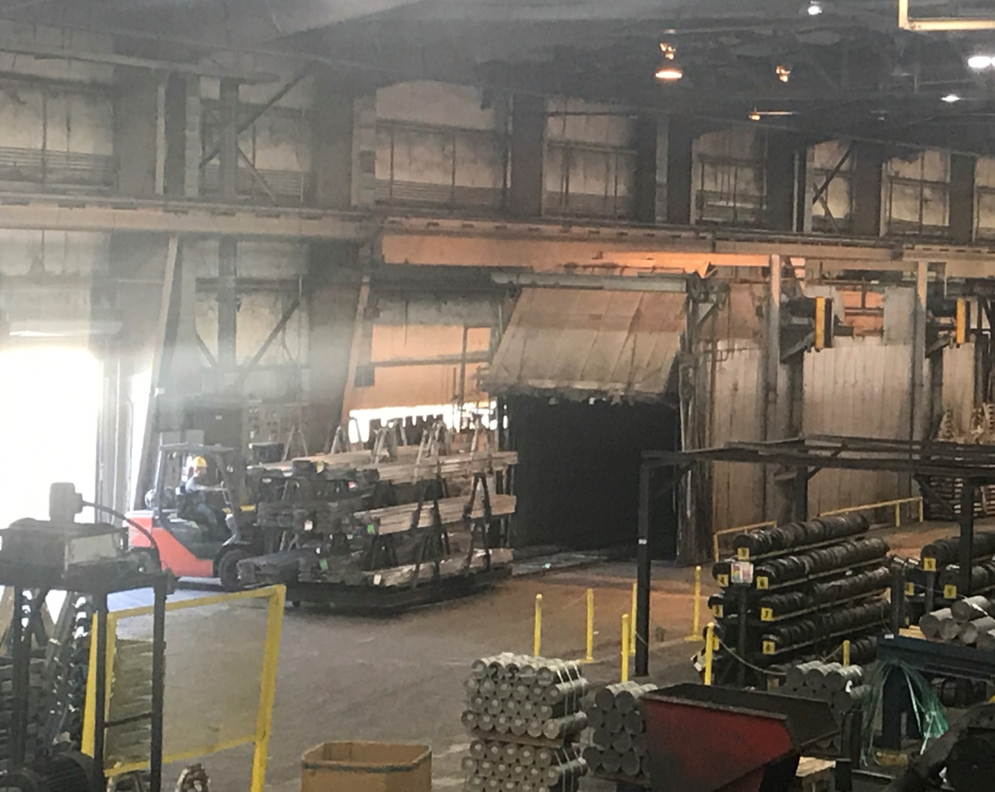
Type 6063 – T5 Aluminum:
Aluminum trim products are precisely manufactured
under extreme tolerances
Extrusions can become a part of the surface
or they can become the feature itself
Profiles are typically found 0.050” thickness
Complex shapes can be realized in one-piece
extruded aluminum sections
Notes:
Type 6063-T5 Aluminum:
Most extruded shapes for architectural use are fabricated from 6063, an aluminum alloy with magnesium and silicon as the alloying elements.
Type 6063-T5 aluminum—commonly referred to as the architectural alloy—has a very smooth surface and is the best alloy suited for anodizing applications.
The T5 designation indicates it has been artificially aged and moderately heat-treated.

Slide 18
Characteristics of Extruded Aluminum:
Fire resistant and non-combustible.
Does not rust
Resilient and can spring back from the shock of impact.
Poses no health or physical hazards - exempt from the requirement of publishing material safety data sheets.
Relatively inexpensive and may not require long lead times.
Can add a design aesthetic to a wide range of interior applications.
Can be easily manufactured to accepted standard dimensional tolerances.
Notes:
Characteristics of Extruded Aluminum:
Extruded aluminum is frequently referred to as a “miracle metal” due to its long list of favorable properties.
It is fire resistant and non-combustible. Even at extremely high temperatures, it does not produce toxic fumes.
It does not rust because aluminum is protected by its own naturally-occurring oxide film.
It is resilient and can spring back from the shock of impact depending on the temper applied.
It poses no health or physical hazards. Aluminum trim products are defined as “articles” by the Occupational Safety and Health Administration (OSHA) and are therefore exempt from the requirement of publishing material safety data sheets.
It is relatively inexpensive and may not require long lead times. Even short-run prototypes often can be produced at moderate cost.
It can add a design aesthetic to a wide range of interior applications.
It can be easily manufactured to accepted standard dimensional tolerances.

Slide 19
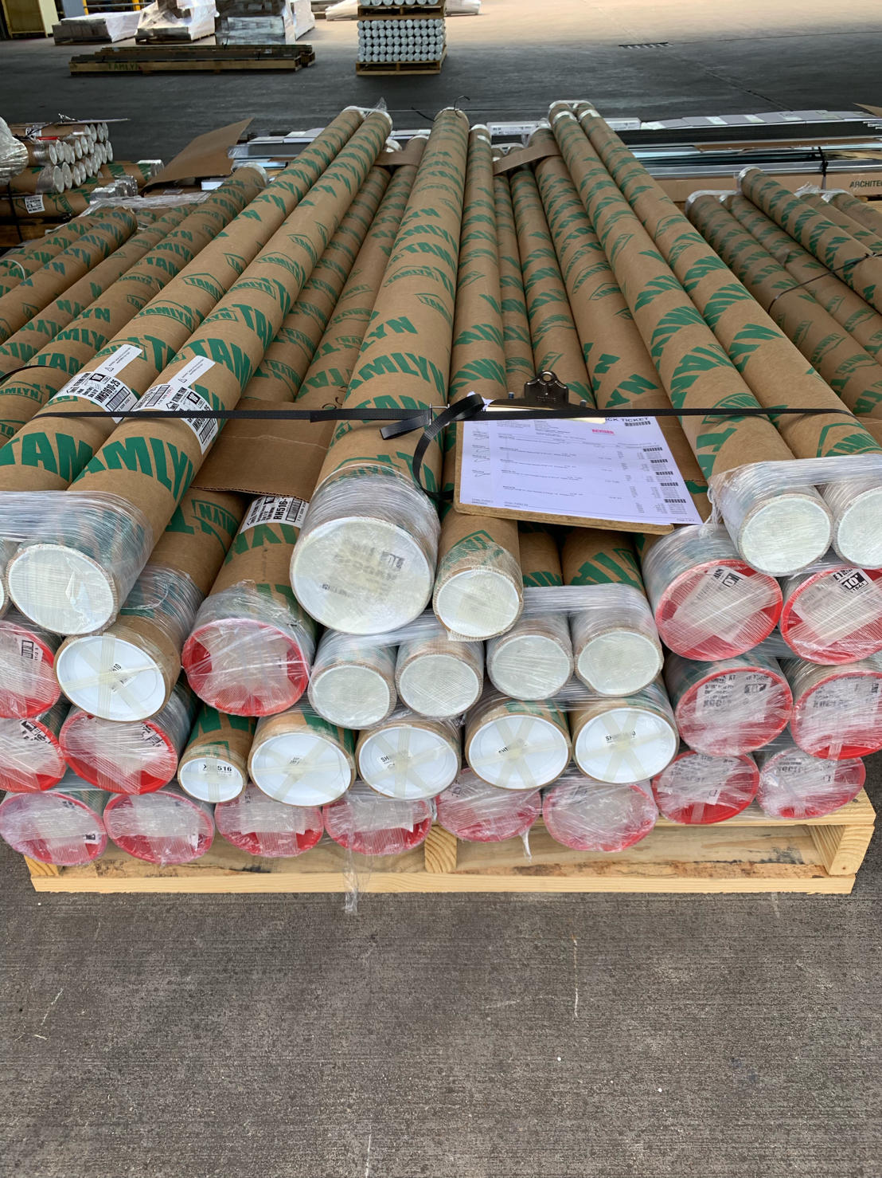
Characteristics of Extruded Aluminum:
Lightweight. Weighs about one-third of most other metals.
Easier to handle and less expensive to ship.
Strong. Trim profiles can be made as strong as needed for most applications. Strength of rigid metal prevents swelling and buckling.
Notes:
Type 6063-T5 Aluminum:
Most extruded shapes for architectural use are fabricated from 6063, an aluminum alloy with magnesium and silicon as the alloying elements.
Type 6063-T5 aluminum—commonly referred to as the architectural alloy—has a very smooth surface and is the best alloy suited for anodizing applications.
The T5 designation indicates it has been artificially aged and moderately heat-treated.

Slide 20
Sustainability:
Extruded Aluminum is constructed from 75% to 100% post-industrial and post-consumer scrap
Extruded Aluminum can help earn LEED® v4 certification
Aluminum is the only material that more than pays for the cost of its own collection
Notes:
Sustainability:
Aluminum is the sustainable material of choice in many markets because of its significant environmental and economic benefits.
Aluminum is constructed from 75 percent to 100 percent post-industrial and post-consumer scrap.
Aluminum is a strong, highly durable material that offers a long service life. The strength of aluminum prevents swelling and buckling.
Aluminum is lightweight, weighing about one-third of most other metals, which makes it easier to handle and less expensive to transport.
Aluminum can help earn LEED® v4 certification:
Energy and Atmosphere Credit: Optimize Energy
Materials and Resources Credit: Building Product Disclosure and Optimization - Environmental Product Declaration (EPD)
Indoor Environmental Quality Credit: Low-Emitting Materials
Aluminum is the only material in the consumer disposal stream that more than pays for the cost of its own collection.
Aluminum produced in North America is more sustainable today then ever before due to technological advances and voluntary environmental efforts. Since 1995, energy required to make new aluminum is down more than a quarter and the industry’s carbon footprint has been reduced nearly 40 percent.

Slide 21
Sustainability:
Materials and Resources (MR)
Building Product Disclosure and Optimization: Environmental Product Declarations (EPD) Credit
Building Product Disclosure and Optimization: Material Ingredients Credit
The intent of these credits are to encourage the use of products and materials for which life-cycle information is available and that have environmentally, economically and socially preferable life-cycle impacts. The intent is also to reward project teams for selecting products from manufacturers who have verified improved environmental life-cycle impacts.
Notes:
Sustainability:
Aluminum is the sustainable material of choice in many markets because of its significant environmental and economic benefits.
Aluminum is constructed from 75 percent to 100 percent post-industrial and post-consumer scrap.
Aluminum is a strong, highly durable material that offers a long service life. The strength of aluminum prevents swelling and buckling.
Aluminum is lightweight, weighing about one-third of most other metals, which makes it easier to handle and less expensive to transport.
Aluminum can help earn LEED® v4 certification:
Energy and Atmosphere Credit: Optimize Energy
Materials and Resources Credit: Building Product Disclosure and Optimization - Environmental Product Declaration (EPD)
Indoor Environmental Quality Credit: Low-Emitting Materials
Aluminum is the only material in the consumer disposal stream that more than pays for the cost of its own collection.
Aluminum produced in North America is more sustainable today then ever before due to technological advances and voluntary environmental efforts. Since 1995, energy required to make new aluminum is down more than a quarter and the industry’s carbon footprint has been reduced nearly 40 percent.

Slide 22
Sustainability:
Indoor Environmental Quality (EQ)
Low-Emitting Materials Credit
The intent of this credit is to reduce concentrations of chemical contaminants that can damage air quality, human health, productivity and the environment. This credit includes requirements for product manufacturing as well as project teams. It covers volatile organic compound (VOC) emissions in the indoor air and the VOC content of materials, as well as the testing methods by which indoor VOC emissions are determined.
Notes:
Sustainability:
Aluminum is the sustainable material of choice in many markets because of its significant environmental and economic benefits.
Aluminum is constructed from 75 percent to 100 percent post-industrial and post-consumer scrap.
Aluminum is a strong, highly durable material that offers a long service life. The strength of aluminum prevents swelling and buckling.
Aluminum is lightweight, weighing about one-third of most other metals, which makes it easier to handle and less expensive to transport.
Aluminum can help earn LEED® v4 certification:
Energy and Atmosphere Credit: Optimize Energy
Materials and Resources Credit: Building Product Disclosure and Optimization - Environmental Product Declaration (EPD)
Indoor Environmental Quality Credit: Low-Emitting Materials
Aluminum is the only material in the consumer disposal stream that more than pays for the cost of its own collection.
Aluminum produced in North America is more sustainable today then ever before due to technological advances and voluntary environmental efforts. Since 1995, energy required to make new aluminum is down more than a quarter and the industry’s carbon footprint has been reduced nearly 40 percent.

Slide 23
Sustainability:
Energy and Atmosphere (EA)
Optimized Energy Performance Credit
The intent of the Optimized Energy Performance credit is to achieve increasing levels of energy performance beyond the prerequisite standard to reduce environmental and economic harms associated with excessive energy use. Extruded aluminum has very good thermal performance, so when used in conjunction with other materials in the wall cladding, can assist in optimizing energy performance.
Notes:
Sustainability:
Aluminum is the sustainable material of choice in many markets because of its significant environmental and economic benefits.
Aluminum is constructed from 75 percent to 100 percent post-industrial and post-consumer scrap.
Aluminum is a strong, highly durable material that offers a long service life. The strength of aluminum prevents swelling and buckling.
Aluminum is lightweight, weighing about one-third of most other metals, which makes it easier to handle and less expensive to transport.
Aluminum can help earn LEED® v4 certification:
Energy and Atmosphere Credit: Optimize Energy
Materials and Resources Credit: Building Product Disclosure and Optimization - Environmental Product Declaration (EPD)
Indoor Environmental Quality Credit: Low-Emitting Materials
Aluminum is the only material in the consumer disposal stream that more than pays for the cost of its own collection.
Aluminum produced in North America is more sustainable today then ever before due to technological advances and voluntary environmental efforts. Since 1995, energy required to make new aluminum is down more than a quarter and the industry’s carbon footprint has been reduced nearly 40 percent.

Slide 24
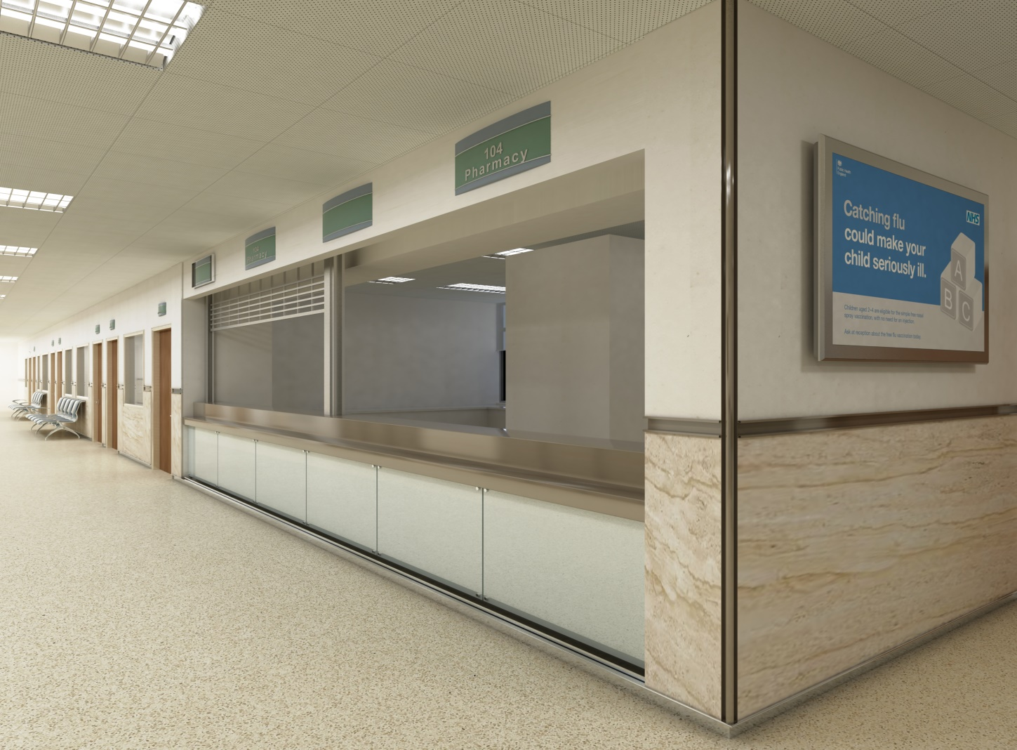
Finish Options
Notes:
Profiles and Finishes

Slide 25
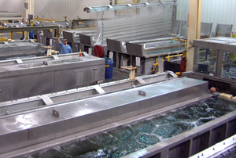
Anodized Finishes:
6063 Aluminum alloy is ideally suited to anodizing
Aluminum oxide is fully integrated with the underlying aluminum substrate, therefore will not chip or peel.
It has a porous structure that permits secondary processes
Notes:
Anodized Finishes:
Aluminum trim products are available in a variety of finishes:
Ready-to-paint finishes for custom color matching using liquid paints (acrylics, alkyds, polyester, and others) or powder coatings
Clear and colored anodized finishes
Aluminum is ideally suited to anodizing, an electrochemical process in which the aluminum is immersed in an acid solution through which electric current is passed. The process converts the metal surface into an anodic oxide finish that is durable, decorative, and corrosion resistant.
Unlike paint or plating, the aluminum oxide is fully integrated with the underlying aluminum substrate; therefore, it will not chip or peel. Additionally, it has a porous structure that permits secondary processes such as coloring and sealing. Although a natural oxidation process occurs when unfinished aluminum is exposed to air, producing the oxide film artificially creates a film that is thicker, harder, and more durable.

Slide 26
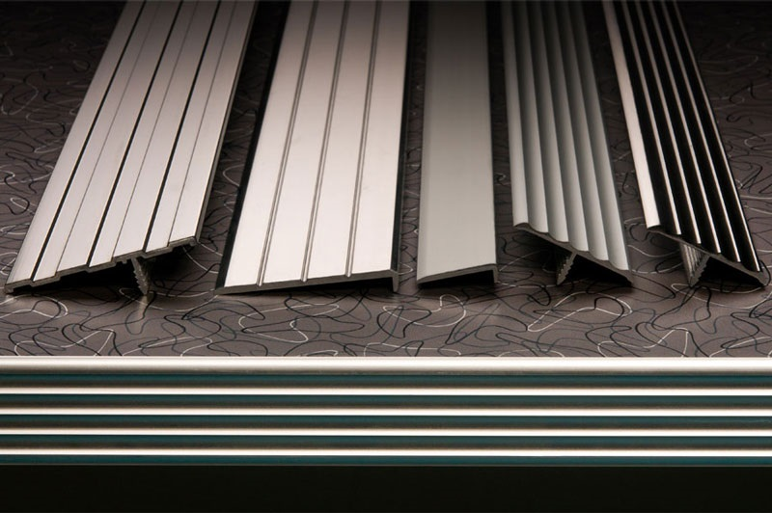
Clear Anodized Finishes:
Protects the surface, while allowing the natural beauty of the aluminum to shine through
Controlled electrochemical conversion process that deposits an oxide film on the aluminum trim.
Natural oxidation occurs on bare aluminum, but the controlled oxidation process artificially creates a thicker, harder, and more durable "oxide film.”
Extremely durable finish, resistant to most forms of corrosion.
Anodized finishes can vary slightly from one piece of trim to another. Design professionals should consider this characteristic before ordering.
Notes:
Clear Anodized Finishes:
The anodic layer of a clear anodizing finish protects the surface, while allowing the natural beauty of the aluminum to shine through.
Painting clear anodized trim is not recommend. Typically, manufacturers provide primed and ready-to-receive-paint profiles that are kept in stock.
If field painting of clear anodized moldings is necessary, the following steps must be taken to improve the bond between the paint and the aluminum surface:
Clean and treat moldings with an acid etch solution (i.e., mild concentration of muriatic acid), then rinse thoroughly and allow to dry. An acid-etched primer is also available.
Use a primer recommended by the paint manufacturer.
Apply the paint coat according to the paint manufacturer’s specifications.

Slide 27
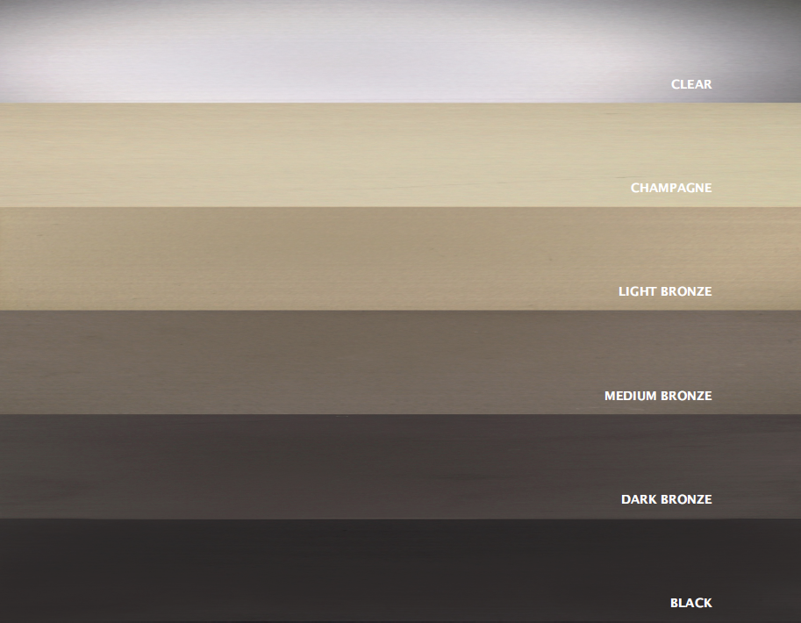
Other Anodized Finishes:
Typical colors: Champagne, Bronze, and Black.
As with clear anodized, finishes can vary from one piece of trim to another.
Typically, color will fall within a certain range, can usually be determined prior to anodizing.
Manufacturer should provide anodized color details upon request.
Notes:
Clear Anodized Finishes:
The anodic layer of a clear anodizing finish protects the surface, while allowing the natural beauty of the aluminum to shine through.
Painting clear anodized trim is not recommend. Typically, manufacturers provide primed and ready-to-receive-paint profiles that are kept in stock.
If field painting of clear anodized moldings is necessary, the following steps must be taken to improve the bond between the paint and the aluminum surface:
Clean and treat moldings with an acid etch solution (i.e., mild concentration of muriatic acid), then rinse thoroughly and allow to dry. An acid-etched primer is also available.
Use a primer recommended by the paint manufacturer.
Apply the paint coat according to the paint manufacturer’s specifications.

Slide 28
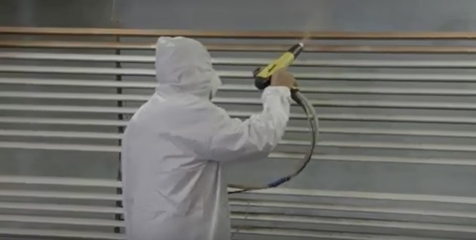
Powder Coated Finishes:
Provides a high-quality finish in almost limitless range of colors
Electrostatic spray deposition is generally used to apply the powder coating to the aluminum substrate
Compared to liquid paints, powder coating provides a more durable finish
Notes:
Powder Coated Finishes:
Powder coating is a dry finishing process that is extremely popular, representing over 15 percent of the total industrial finishing market. It provides a high-quality, attractive finish in an almost limitless range of colors.
Powder coatings are based on polymer resin systems, blended with curatives, pigments, leveling agents, flow modifiers, and other additives. The ingredients are melt mixed, cooled, then ground into a powder. A process known as electrostatic spray deposition (ESD) is generally used to apply the powder coating to the aluminum substrate. After application of the powder coating, the substrate is heat cured where the coating chemically reacts to produce long molecular chains that are very resistant to breakdown.
Compared to liquid paints, powder coating provides a more durable finish that offers greater resistance to diminished coating quality resulting from impact, moisture, chemicals, ultraviolet light, and harsh weather conditions. In turn, this reduces the risk of scratches, chipping, corrosion, fading, and other wear issues.

Slide 29
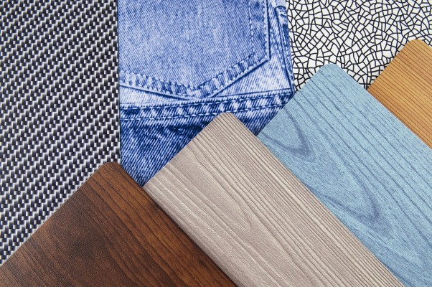
Custom Pattern Finishes:
Notes:
Powder Coated Finishes:
Powder coating is a dry finishing process that is extremely popular, representing over 15 percent of the total industrial finishing market. It provides a high-quality, attractive finish in an almost limitless range of colors.
Powder coatings are based on polymer resin systems, blended with curatives, pigments, leveling agents, flow modifiers, and other additives. The ingredients are melt mixed, cooled, then ground into a powder. A process known as electrostatic spray deposition (ESD) is generally used to apply the powder coating to the aluminum substrate. After application of the powder coating, the substrate is heat cured where the coating chemically reacts to produce long molecular chains that are very resistant to breakdown.
Compared to liquid paints, powder coating provides a more durable finish that offers greater resistance to diminished coating quality resulting from impact, moisture, chemicals, ultraviolet light, and harsh weather conditions. In turn, this reduces the risk of scratches, chipping, corrosion, fading, and other wear issues.

Slide 30
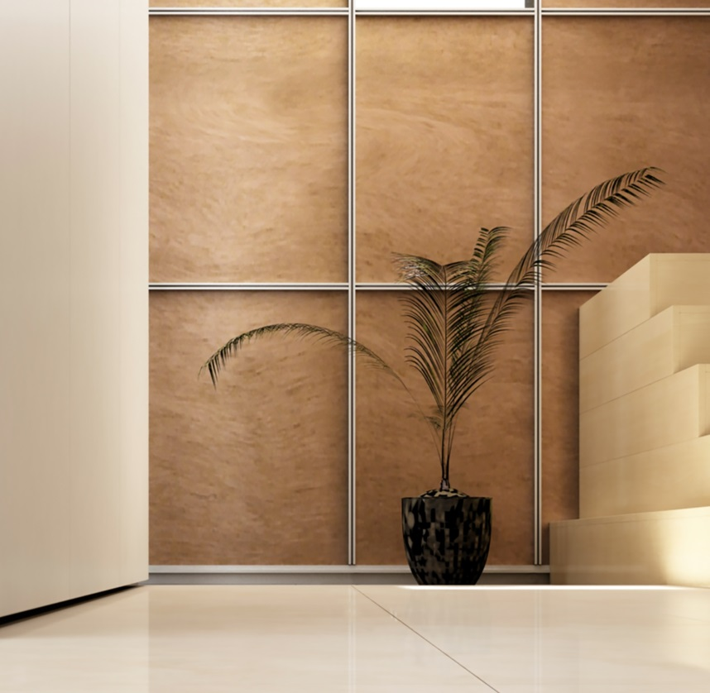
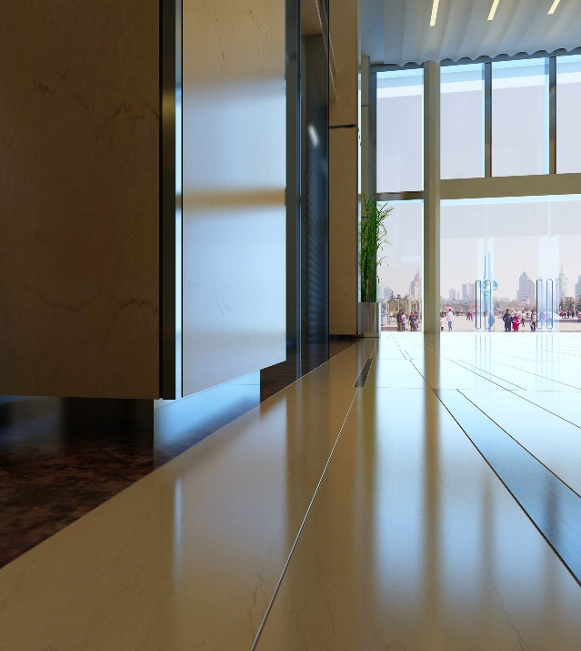
Profile Offerings:
Bases
Reveals
2pc System
Channels
Inserts
Corners
Moldings
Custom Designs
Notes:
Product Offerings:
Product offerings include simple reveals and transitions that enrich the aesthetics of drywall surfaces.
Well beyond that, manufacturers have created shapes and forms that introduce the appearance of fine metal craft integrated with drywall and panelized surfaces at a fraction of the cost of having custom metalwork designed, detailed, and fabricated for a project.

Slide 31
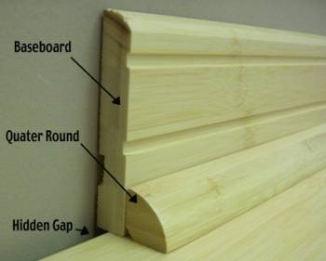
Standard Base Detail:
Typically a 3 ½ - 4 inch profile installed on top of the drywall
Quarter round is sometimes used as a flooring joint
Some modernists question the utility of the traditional baseboard
Notes:
Standard Base Detail
The baseboard detail is one of the more prominent details to consider in interior design as it serves to cover the joint between the finished wall and floor; as well, it protects a highly trafficked area of an interior space. There are several options of base details to consider and each has its place in every designer’s toolbox. Before we introduce the topic of extruded aluminum bases, we’ll do a quick recap of some common base options, beginning with a standard applied base.
A standard base detail is typically a 3 ½-inch profile installed on top of the drywall.
With some applications, quarter round is used as a flooring joint between the flooring and the baseboard for aesthetic appeal.
Some modernists have questioned the utility of the traditional baseboard; consequently, a number of contemporary options have evolved that provide the design community with more options.

Slide 32
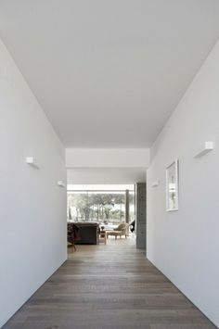
Reveal Base – No Base :
Creates a simple, minimalistic aesthetic
The joint between the wall and floor should be kept open
Reduces the material, installation, and finishing costs
Wall base is more susceptible to damage
Generally used in industrial or commercial applications
Requires taping of the lower edge of the drywall
Notes:
No Base:
Eliminating the baseboard completely creates a simple, minimalistic aesthetic.
The joint between the wall and floor should be kept open with a ¾-inch reveal (shadow line) to allow the surfaces to move independently. This is accomplished by separating the drywall from the floor with a piece of Z-metal.
A baseless option reduces the material, installation, and finishing costs of a conventional baseboard.
On the downside, the wall base is more susceptible to damage from foot traffic and equipment; therefore, it is generally used in industrial or commercial applications where there is minimal foot traffic and less risk of damage. Eliminating the baseboard requires taping of the lower edge of the drywall and there is less tolerance for error in the drywall finishing process.

Slide 33
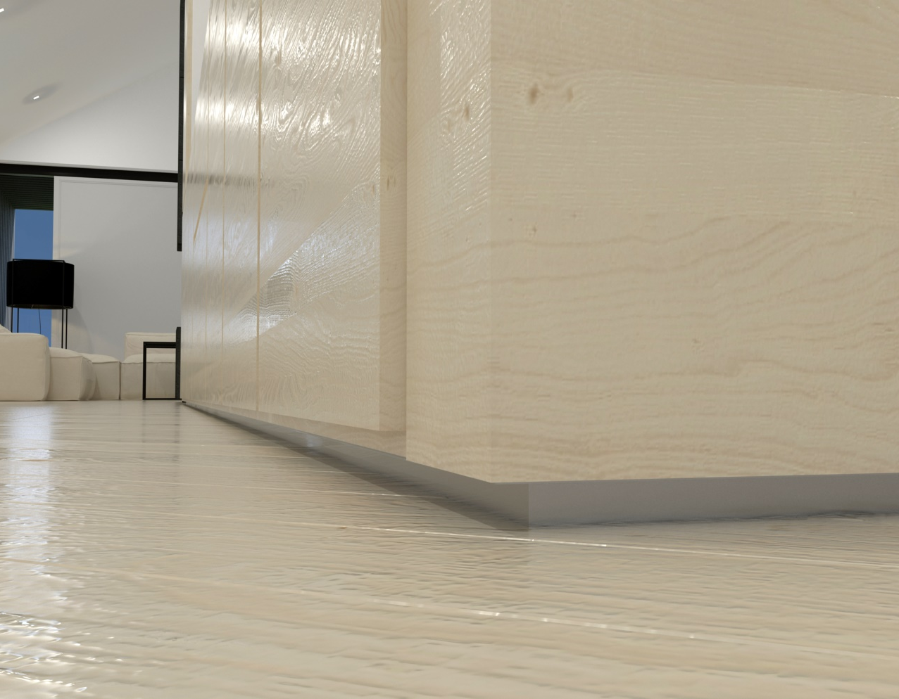
Reveal Base – Shadow Base:
Separates and expresses the joint between materials
Popular in modern architecture
Traditional materials: metal or plastic
Offers great design flexibility
wide range of sizes and profiles
can be painted
can be carried through to door and window trim
Notes:
Reveal Base:
The reveal base separates and expresses the joint between materials and is a popular technique in modern architecture.
Consisting of metal or plastic, the reveal base is placed between the base of the wall and the floor to create a shadow line between the surfaces. It is particularly appealing when used to separate different materials as the reveal tends to make the wall look like it is floating.
Reveal bases offer great design flexibility as they provide a clean edge that is easy to finish, and they are available in a wide range of sizes and profiles. Furthermore, a reveal base can be painted to match or contrast with the wall color. The reveal can be incorporated into the larger design statement of the project by carrying it through to the door and window trim. Custom reveal bases can be field fabricated from virtually any material.
Next, we’ll look at reveal base products made from extruded aluminum.

Slide 34
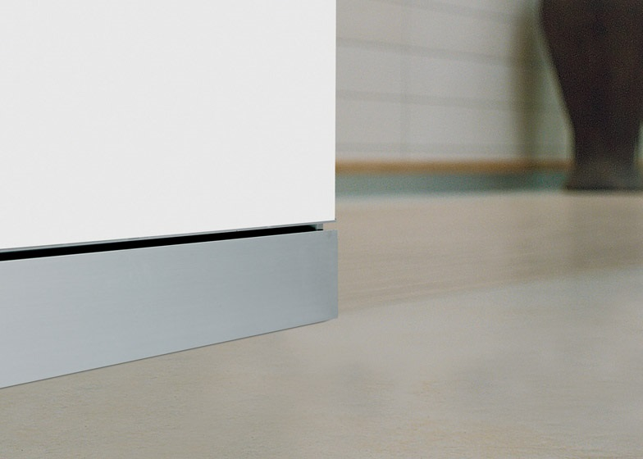
Flush Base:
Recessed, flush with the wall
Clean, unencumbered look
Common materials: wood and MDF
Requires considerable planning and care to install
Wall and base fastened to underlying substrate
Notes:
Flush Base:
A flush base (typically 3 ½-inch or 5 ½-inch) is recessed so it is flush with the wall.
It provides a clean, unencumbered look that pairs well with a modern interior.
Common materials for a flush base include wood and medium density fiberboard (MDF).
Although a flush base addresses wall protection issues and minimizes dust collection, it requires considerable planning, work, and care to install.
Both the finished wall surface and the base should be fastened to the same underlying substrate to prevent the joint from cracking.

Slide 35
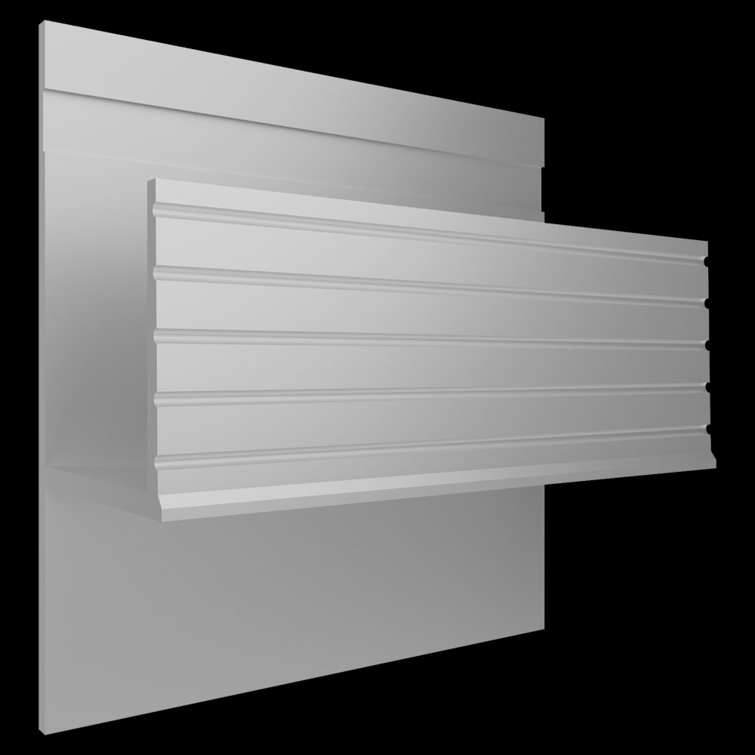
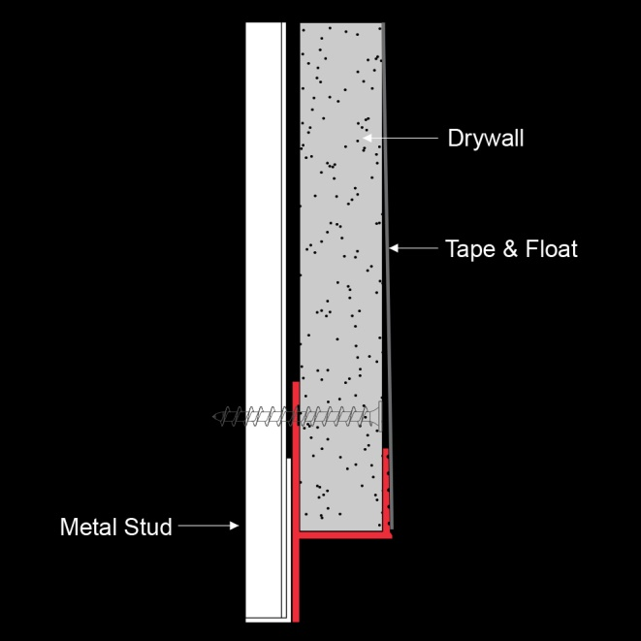
Bases: Shadow Line Reveal
This profile provides the Reveal Base look but it has a tape and float edge that will protect the exposed lower edge of the drywall panel and give you a consistent reveal across the length.
Notes:
Bases: Reveal Double Flange:
Pictured here is another example of a base configuration.

Slide 36
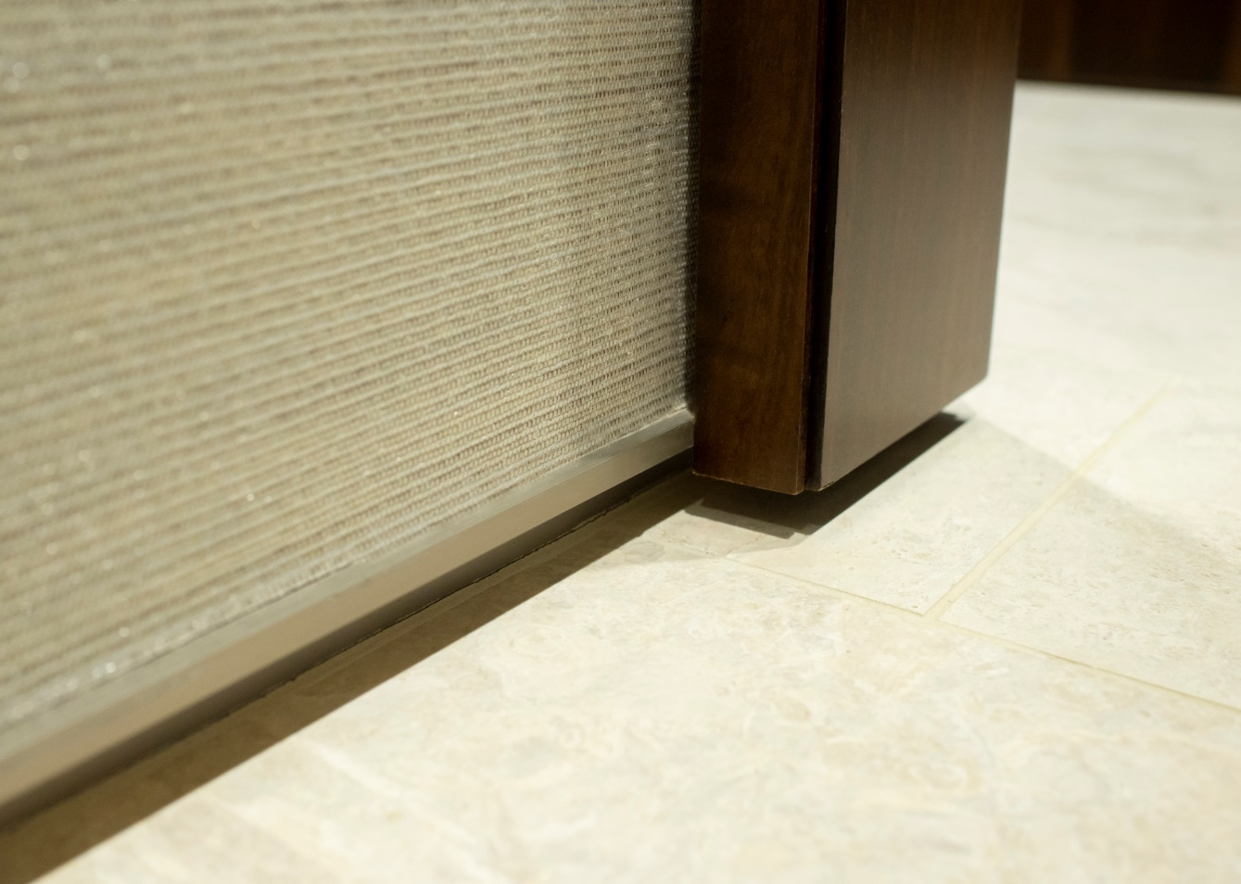
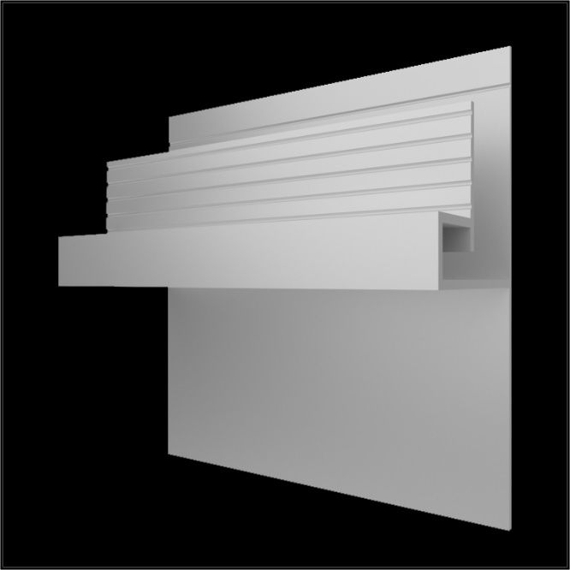
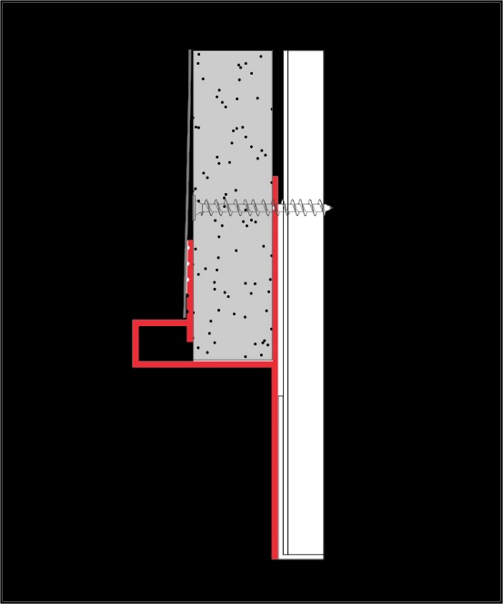
Bases: Projecting Square
Notes:
Bases: Projecting Square:
Pictured here is an example of a base configuration.

Slide 37
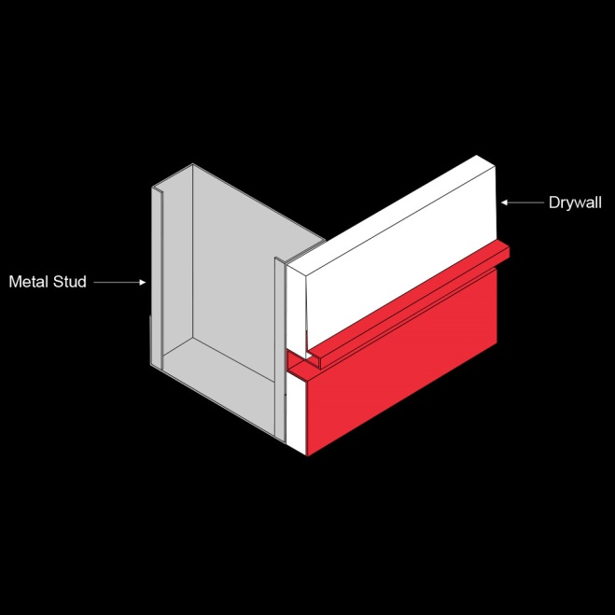
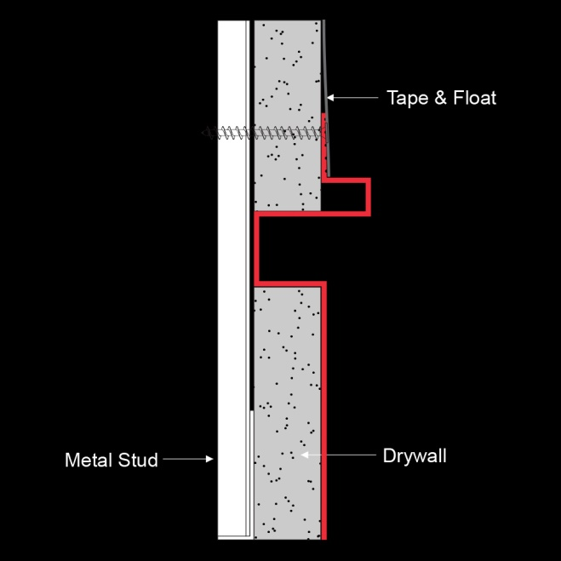
Bases: Flush Projecting Square
This profile gives a flash base with an square accent detail.
Notes:
Bases: Reveal Double Flange:
Pictured here is another example of a base configuration.

Slide 39
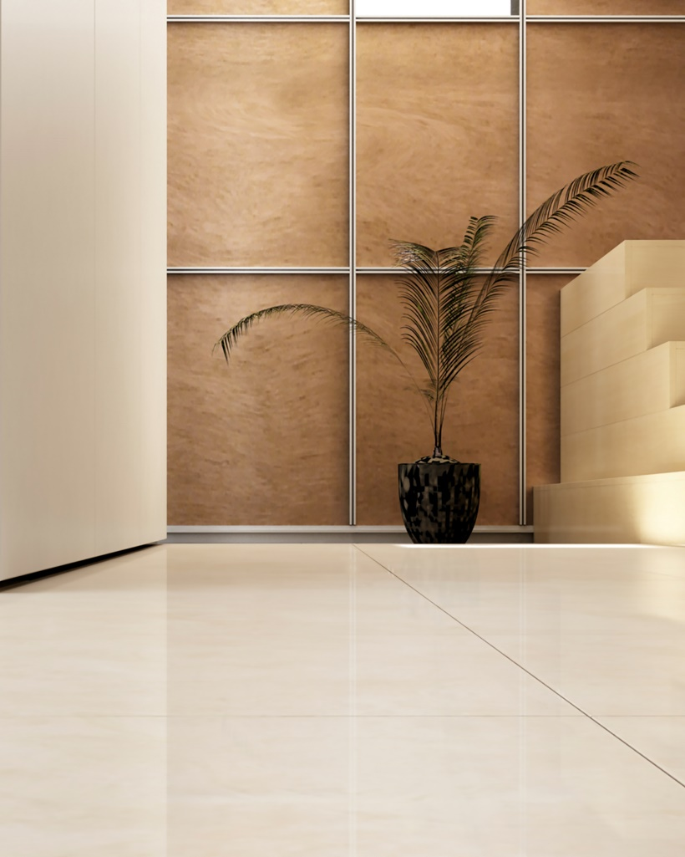
Extruded Aluminum Reveals:
Notes:
Extruded Aluminum Reveals:
Extruded aluminum reveals are installed vertically, horizontally, and/or diagonally are available in a range of styles to satisfy a variety of design requirements

Slide 40
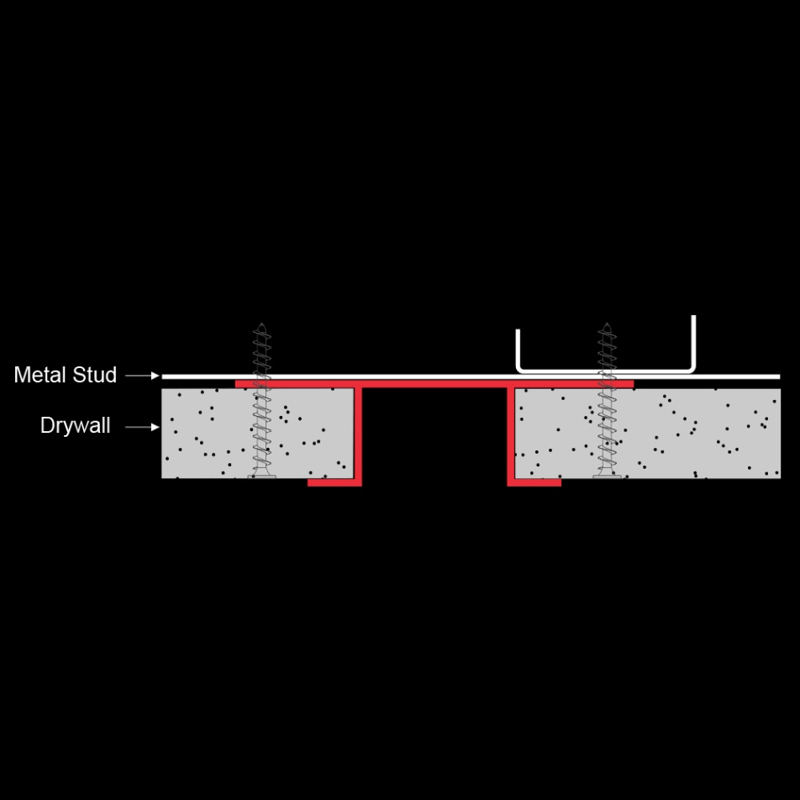
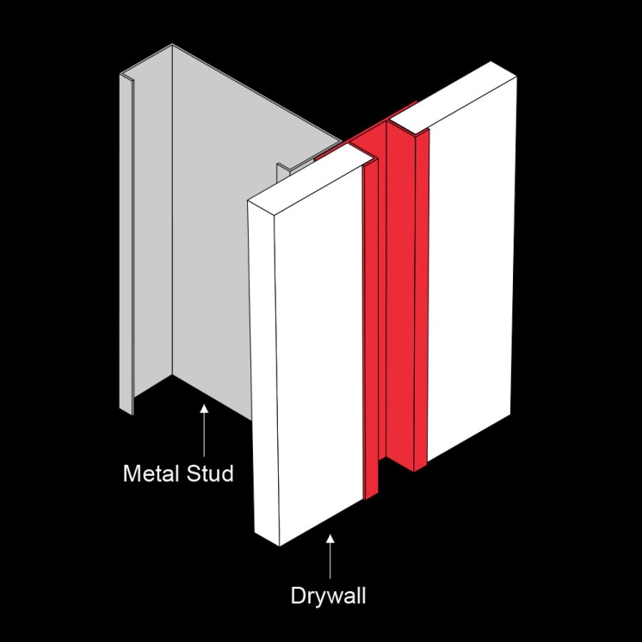
Reveals: Flange Reveal
Strictly a decorative detail
Aluminum allows installation vertically, horizontally, diagonally
Widths: ¼ inch up to 4 inches
Notes:
Square Reveals:
Reveals—used to create shadow lines or to break/separate materials—do not provide a structural function; they are strictly a decorative detail.
Material options include PVC vinyl and aluminum.
Aluminum reveals create an appealing recess that allows installation vertically, horizontally, or diagonally.
They are available in widths from ¼ inch up to 4 inches.

Slide 41
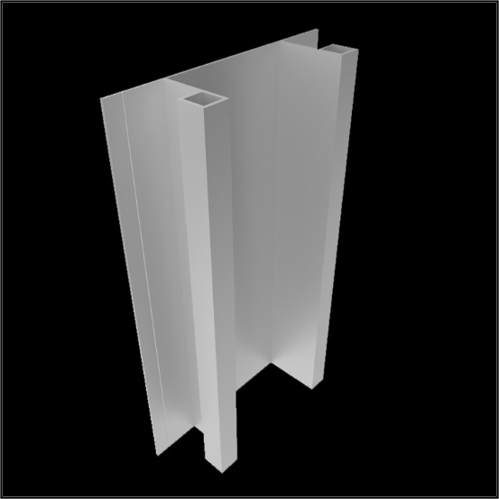
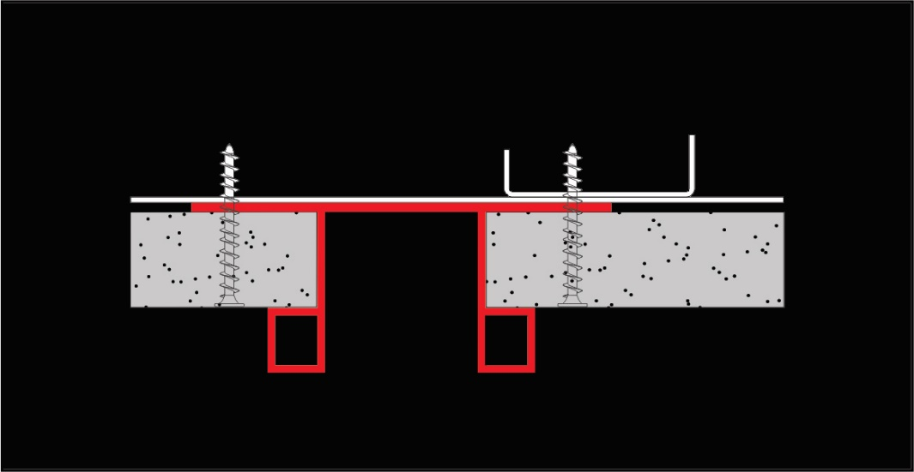
Reveals: Square Reveal
. Mulitple sizes, shapes and finishes available
Notes:
Square Reveals:
Reveals—used to create shadow lines or to break/separate materials—do not provide a structural function; they are strictly a decorative detail.
Material options include PVC vinyl and aluminum.
Aluminum reveals create an appealing recess that allows installation vertically, horizontally, or diagonally.
They are available in widths from ¼ inch up to 4 inches.

Slide 42
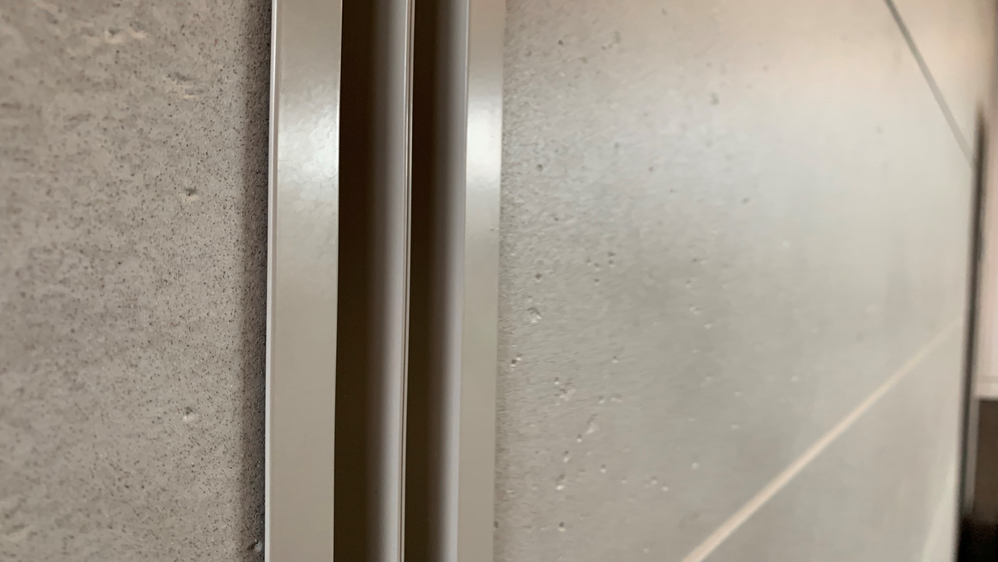

Slide 43
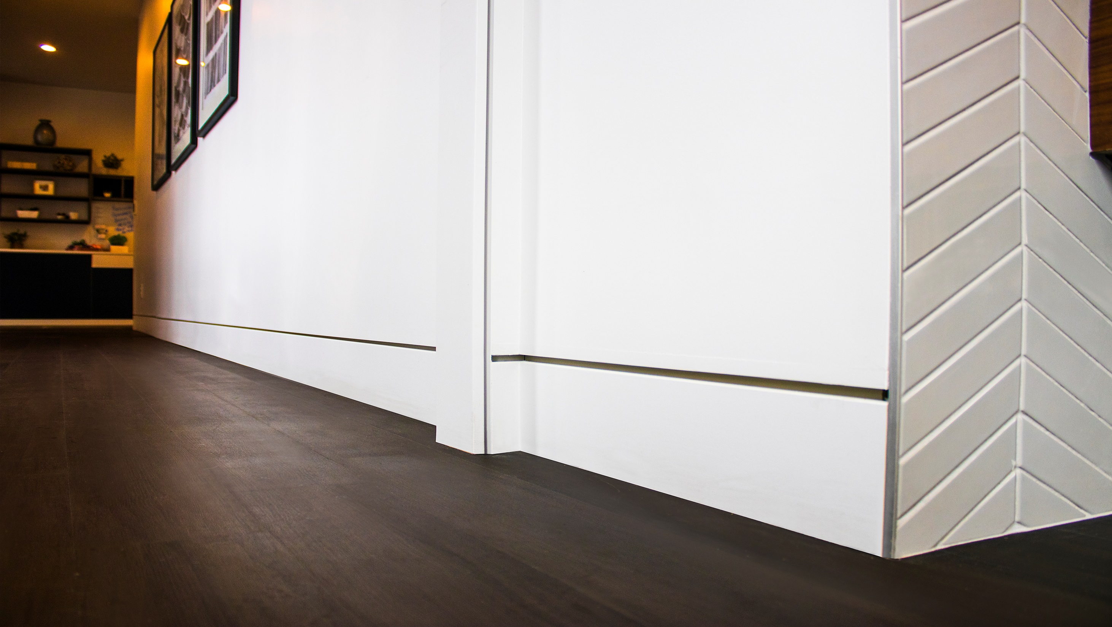

Slide 44
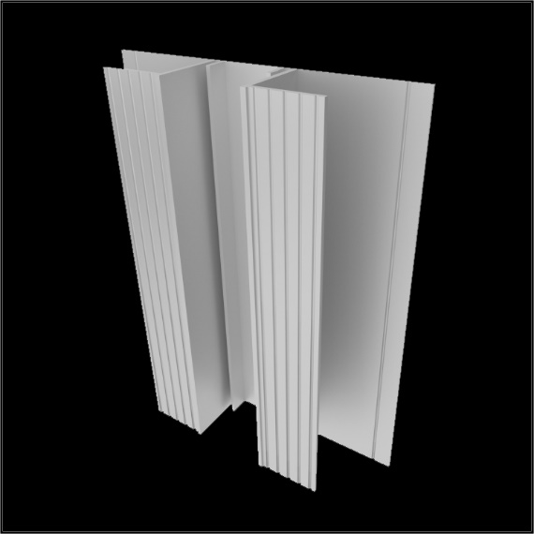
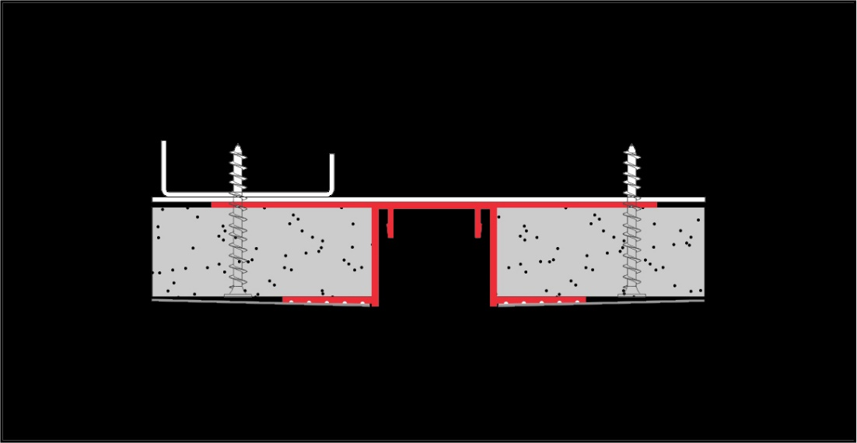
Channels: Flush
Utilized in two-piece systems (channels and inserts)
Installed vertically or diagonally and in approved conditions, horizontally
Ridged face provides for taping and floating
Notes:
Channels: Flush Square:
Aluminum anchor channels are utilized in two-piece systems (channels and inserts) and can be installed vertically or diagonally (no less than 30 degrees), and in approved conditions, horizontally.
Pictured here is a flush square style. The ridged face provides for taping and floating and allows the insert piece to appear to stand alone.

Slide 45
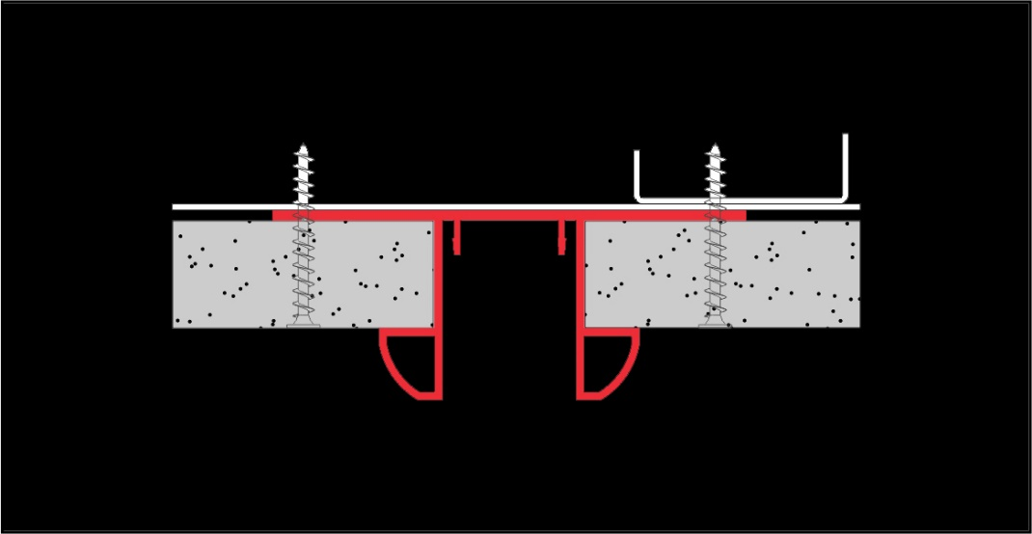
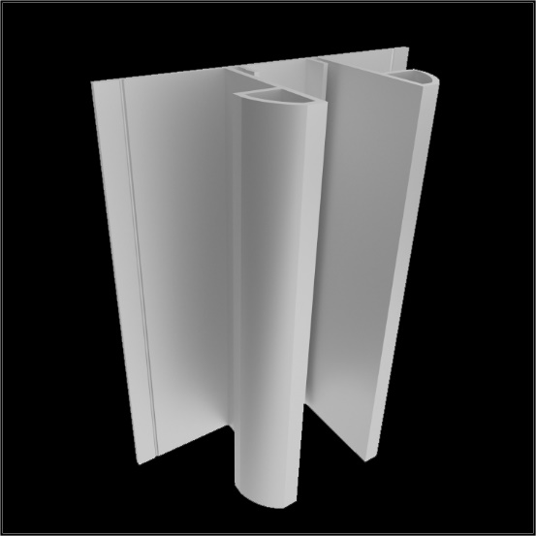
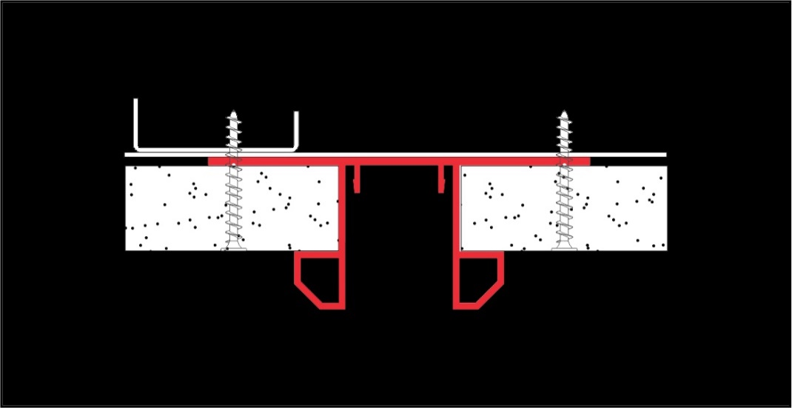
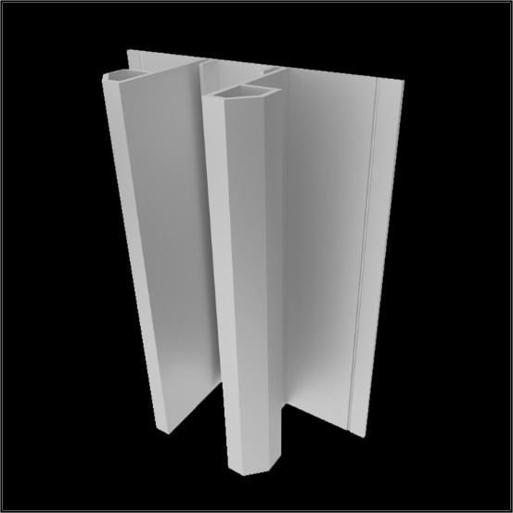
Channels: Square Tapered & Square Angled
Unique tapered square edges create a dynamic look when paired with an insert piece
Angled detail adds a unique touch to a classic look
Notes:
Channels: Square Tapered & Square Angled:
Channels are available in a range of configurations; a couple of examples are pictured here.

Slide 46
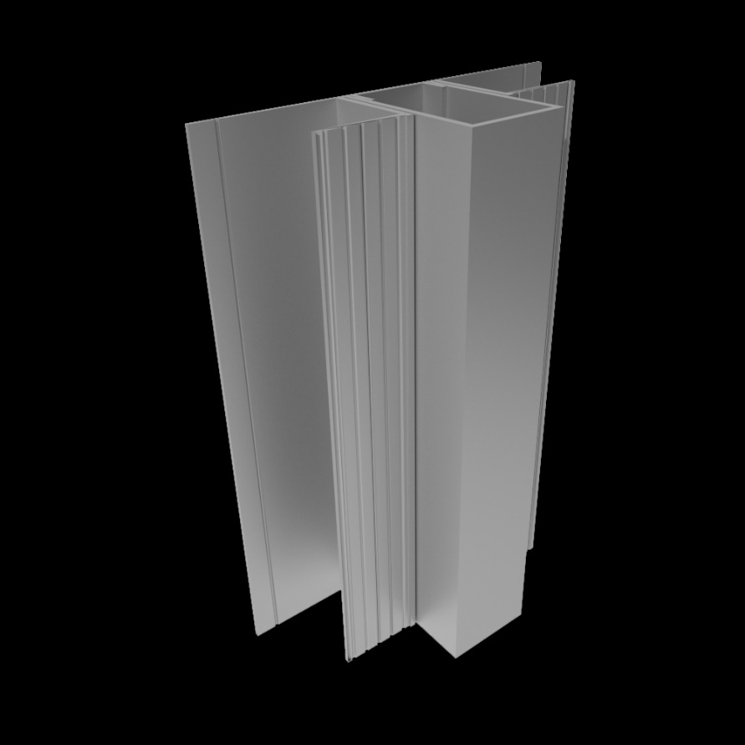
Inserts: Rectangular Square
Inserts are paired with channel reveals and may be installed vertically or diagonally
Utilized to create both modern and classic looks in drywall or panel installations
Rectangular square insert is available in 1-inch and 2-inch projections
Notes:
Inserts: Rectangular Square:
Aluminum inserts are paired with channel reveals and may be installed vertically or diagonally.
Available in a variety of styles, inserts can be utilized to create both modern and classic looks in drywall or panel installations. Depending on projection lengths, spacing, etc., inserts can be designed to provide shadow lines or optical illusions.
The rectangular square insert pictured at right is available in 1-inch and 2-inch projections.

Slide 47
Inserts
Available in Flush, 1-inch, 2-inch, and 3-inch projections
Available in 1-inch, 2-inch, and 3-inch projections
Notes:
Inserts: Projecting Radiused Square & Blade Rectangular Round:
Examples of aluminum inserts.

Slide 49
Extruded Aluminum Corners:
Notes:
Extruded Aluminum Reveals:
Extruded aluminum reveals are installed vertically, horizontally, and/or diagonally are available in a range of styles to satisfy a variety of design requirements

Slide 50
Corners:
Compared to PVC rubber, aluminum corner trim profiles offer:
superior protection
greater longevity
more design options
Available in square, radiused, round, elliptical, and tapered configurations
Notes:
Corners:
Corner trim profiles are made with PVC rubber or aluminum.
Aluminum corner trim profiles are available that provide a design feature, finished edge, and protection for vertical drywall or panel corners.
Compared to PVC rubber, aluminum corners offer superior protection while creating beautiful lines, reveals, and shadows. Furthermore, aluminum has greater longevity and more design options. A wide variety of corner trims are offered, including square, radiused, round, elliptical, and tapered.
Some examples of extruded aluminum corners are pictured on subsequent slides.

Slide 51
Corners: Eliptical & Round
The reveal in each of these profiles creates the illusion of a floating corner.
Notes:
Corners: Eliptical & Round

Slide 52
Corners: Rectangular & Open
The rectangular profile is a good complement to hallways and transitions from open to linear spaces well.
Here is the open profile which is a more contemporary treatment for outside corners.
Notes:
Corners: Eliptical & Round

Slide 53
Installation:
Notes:
Installation

Slide 54
Installation Introduction:
Ensure correct layout and placement and that blocking has been provided
All trim work can be applied to walls and ceilings and floated in flush with a gypsum board surface or installed with panels
Follow the gypsum board/panel manufacturer’s best practice application when installing any aluminum trim accessory
Profiles are for aesthetic purposes only
Notes:
Installation: Introduction:
In this last section of the course we review the installation considerations related to aluminum trim products. To facilitate a successful installation, it is important to read the construction drawings to ensure correct layout and placement and, where necessary, make sure that blocking has been provided.
All trim work can be applied to walls and ceilings and floated in flush with a gypsum board surface or installed with panels such as wood, glass, and tile work. Although the profiles are designed to be taped and floated, you can also utilize a fabric that can be wrapped around the channel, or the fabric can be cut and applied with an adhesive.
Follow the gypsum board manufacturer’s best practice application when installing any aluminum trim accessory.
Note that the profiles are for aesthetic purposes only and are not intended to be used as structural members or part of a structural design.

Slide 55
Cutting Aluminum Trim:
An outside corner is the best place to begin installation of aluminum trim profiles
Can be cut with a chop saw, using a non-ferrous carbide miter saw blade
It is recommended that lubricant be applied to the blade before each cut
Notes:
Cutting Aluminum Trim:
An outside corner is the best place to begin installation of aluminum trim profiles.
Aluminum trim can be cut with a chop saw, using a non-ferrous carbide miter saw blade (an abrasive cut-off wheel should never be used to cut aluminum trims).
It is recommended that lubricant be applied to the blade before each cut. The lubricant should be cleaned off of the trim prior to painting and installation.

Slide 56
Installation
Moldings are to be installed while the drywall/gypsum board is being installed
The framing/blocking should provide a backer
Before the taping process begins, installation flanges should be cleaned
Notes:
Installation: Tape & Float Flanges:
Moldings with tape and float flanges are to be installed while the drywall/gypsum board is being installed. The installer must provide space for the moldings at the time of the drywall/gypsum board installation or be prepared to cut the drywall/gypsum board with a router.
The framing/blocking should provide a backer so that moldings can be attached with (recommended) #6 drywall screws 16 inches on center.
Before the taping process begins, installation flanges should be cleaned.
If veneer plaster is specified, the installation flanges must be treated with a bonding agent. Reveals should be masked to prevent compound joint, drywall mud, or texture overspray from entering the reveal opening.

Slide 58
Installation: Tape & Float Flanges
Painted aluminum moldings should be masked with vinyl tape or cloth
Drywall tape should not overlap the edge of the reveal
An 8-inch-wide trowel should be used to apply the final skim coat
Notes:
Installation: Tape & Float Flanges:
Painted aluminum moldings should be masked with vinyl tape or cloth specifically manufactured for masking anodized aluminum trims.
Drywall tape should not overlap the edge of the reveal.
An 8-inch-wide trowel should be used to apply the final skim coat. Note that fiberglass or self-adhesive drywall tape will shorten taping time and assist in the prevention of possible cracking.

Slide 59
Installation: Without Tape & Float Flanges
Moldings are to be installed concurrently during the drywall/gypsum board installation
The framing/blocking should provide a backer so that moldings can be attached with #6 drywall screws 16 inches on center
Reveals should be masked
Notes:
Installation: Without Tape & Float Flanges:
Trim without tape and float flanges is to be installed prior to the drywall/gypsum board being installed.
The framing should provide a backer so that moldings can be attached with #6 drywall screws 16 inches on center.
Reveals should be masked in order to prevent compound joint, drywall mud, or texture overspray from entering the reveal opening.

Slide 60
Application Examples:
Notes:
Application Examples:

Slide 61
Application Examples:
Notes:
Application Examples:

Slide 62
Application Examples:
Notes:
Application Examples:

Slide 63
Notes:
Summary:

Slide 64
Learning Objective Recap:
Copyclip
explain how extruded aluminum trim products can be utilized to improve and enhance drywall surfaces
explain the basic process of extruding aluminum
summarize the sustainable features and performance characteristics of aluminum
discuss the various profile and finish options that are available for aluminum interior trim products, and
state the methods and considerations related to the installation of aluminum trim products for interior spaces.
Notes:
Learning Objectives:
explain how extruded aluminum trim products can be utilized to improve and enhance drywall surfaces
summarize the sustainable features and performance characteristics of aluminum
discuss the various profile and finish options that are available for aluminum interior trim products, and
state the methods and considerations related to the installation of aluminum trim products for interior spaces.

